Slide 1

DC-DC Converter for PV Module Integration
Group 760

Slide 2

CONTENT
INTRODUCTION
CONVERTER DESIGN
MPPT ALGORITHM
TESTS RESULTS
DISCUSSION
CONCLUSION

Slide 3
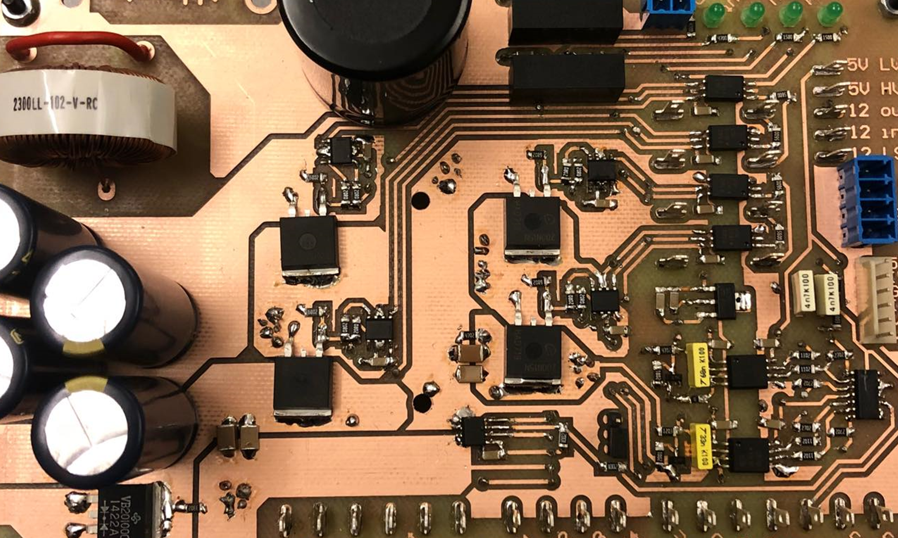
Introduction

Slide 4

Motivation
Global need of transition towards clean energy.
Wind and solar energy production as fastest growing method in 2017.
Improve current generation efficiencies.

Slide 5
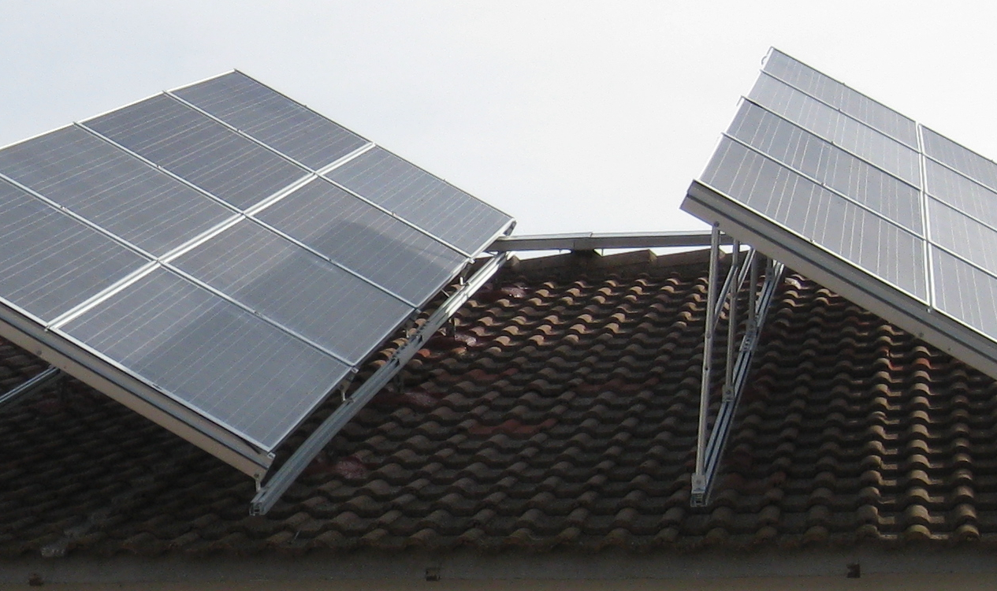
Existing problem
Power mismatches:
Production tolerances.
Partial shading.
Cracks.
Uneven aging.
Dirt.
Partial shaded PV panel [2]

Slide 6
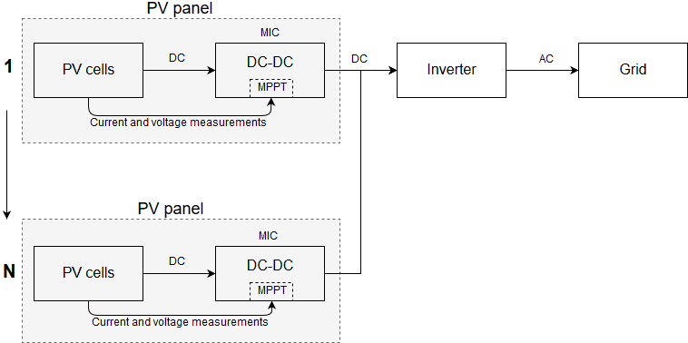
What is a module integrated converter (MIC)?
Is a part of each PV module.
Prevents mismatch losses.
Serial or parallel arrangements.

Slide 7
Why MICs?
Advantages:
Allows individual maximum power point tracking.
Replaces bypass diode.
Higher system efficiencies achieved under mismatches.
Certain topologies allow bidirectionality.
Disadvantages:
Could imply lower efficiency under specific cases.
Production cost increase.

Slide 8
Problem statement and objectives
How can a module integrated converter be designed to maximize
the PV power generation under real conditions?
Objectives:
Design a DC-DC converter for integration with a PV panel.
Implementation of an MPPT algorithm.
Hardware implementation of the MIC.
Test of the system and validation of the MIC.

Slide 9
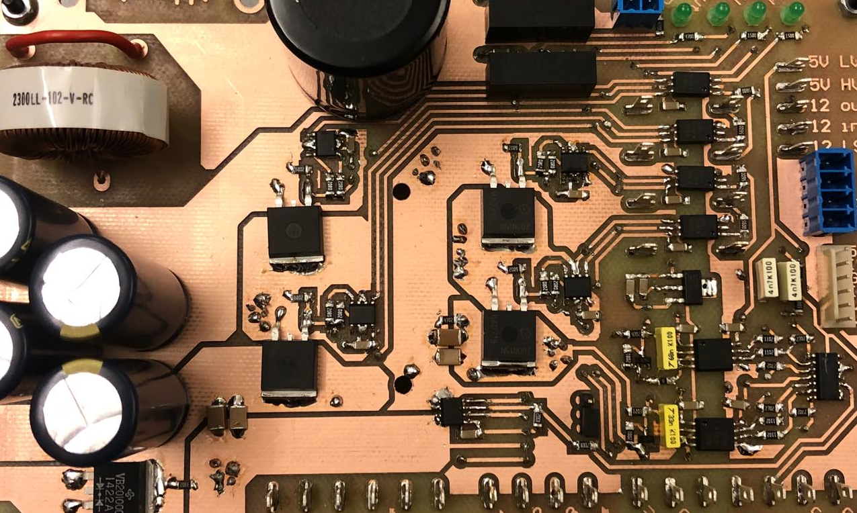
Converter Design

Slide 10
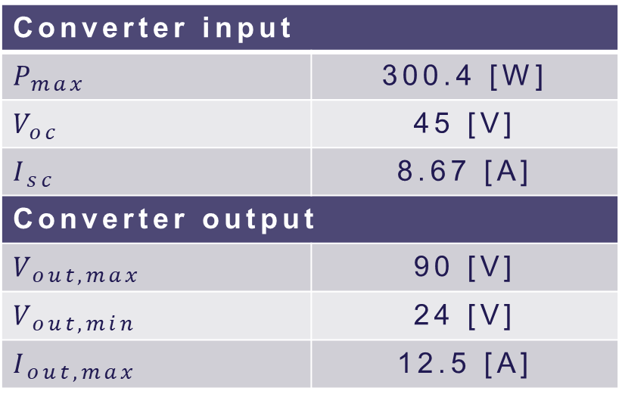
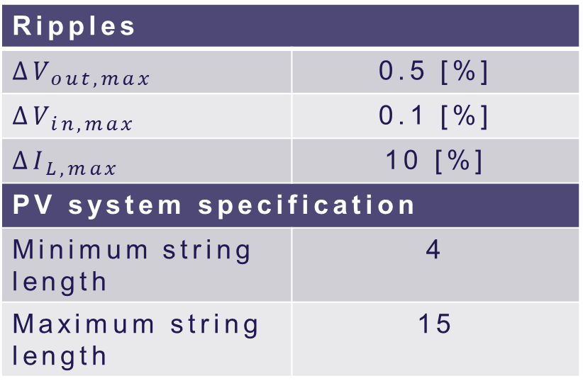
System requirements
Converter input
$$P_{max}$$ | 300.4 [W]
$$V_{oc}$$ | 45 [V]
$$I_{sc}$$ | 8.67 [A]
Converter output
$$V_{out,max}$$ | 90 [V]
$$V_{out,min}$$ | 24 [V]
$$I_{out,max}$$ | 12.5 [A]
Ripples
$$∆V_{out,max}$$ | 0.5 [%]
$$∆V_{in,max}$$ | 0.1 [%]
$$∆I_{L,max}$$ | 10 [%]
PV system specification
Minimum string length | 4
Maximum string length | 15
Notes:
How did we select the values
Input from PV panel
Output from inverter voltage and # of panels
# of panels from minimum and maximum duties
Ripples so we dont mess with the PV panel

Slide 11
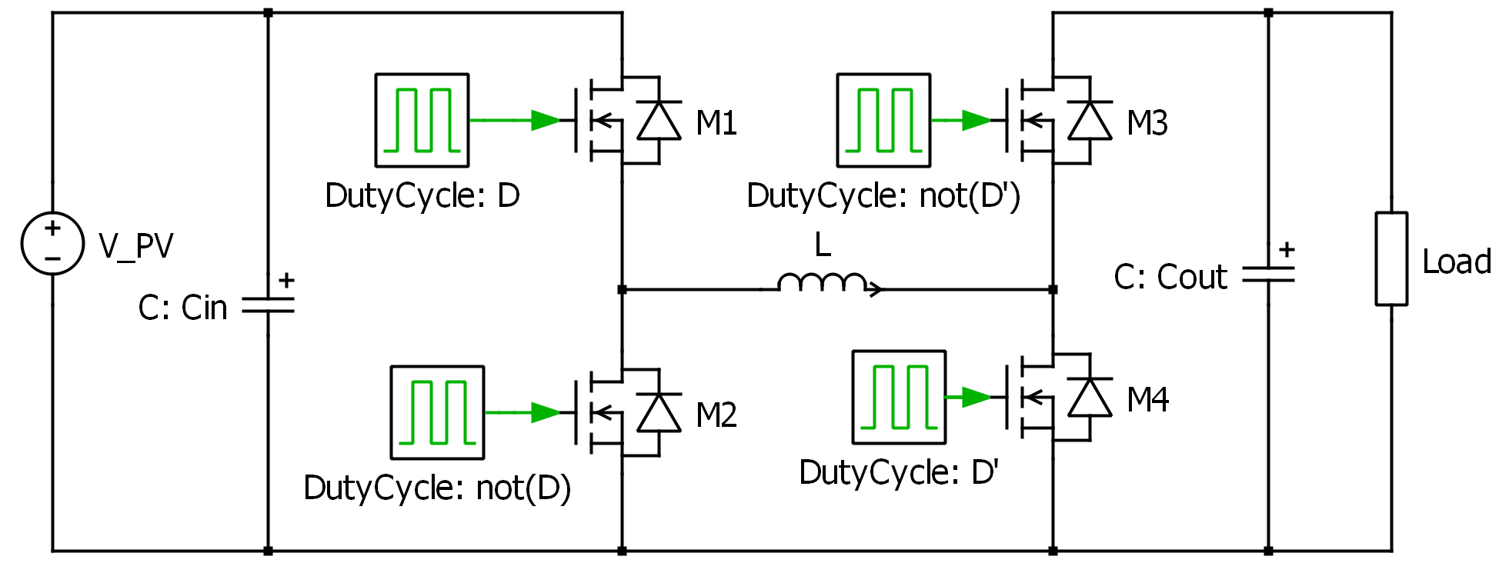
Selection of topology
Non-inverting buck-boost converter
Notes:
Capabilities of both higher and lower output voltage
2 or 4 MOSFETs
Bidirectional opportunities
Lower (conduction) losses

Slide 12
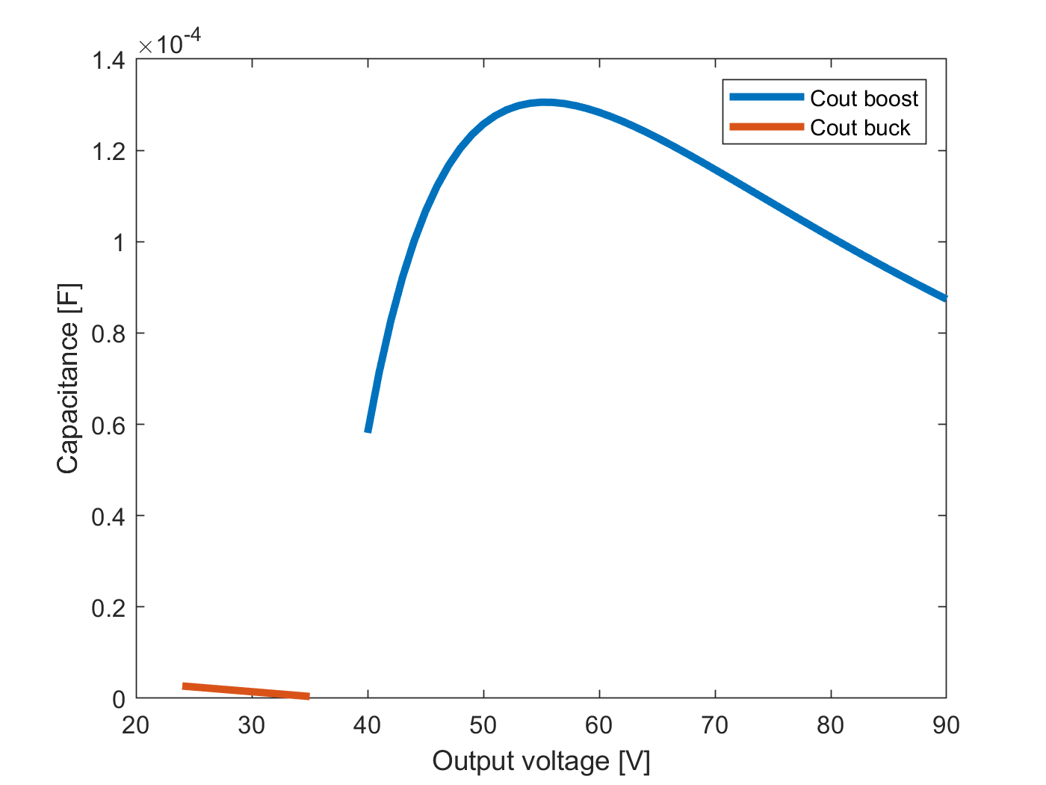
Passive components Sizing
Calculated using the ripples
Finding worst case conditions
Depends on switching frequency
Notes:
Did a voltage sweep to determine worst case

Slide 13
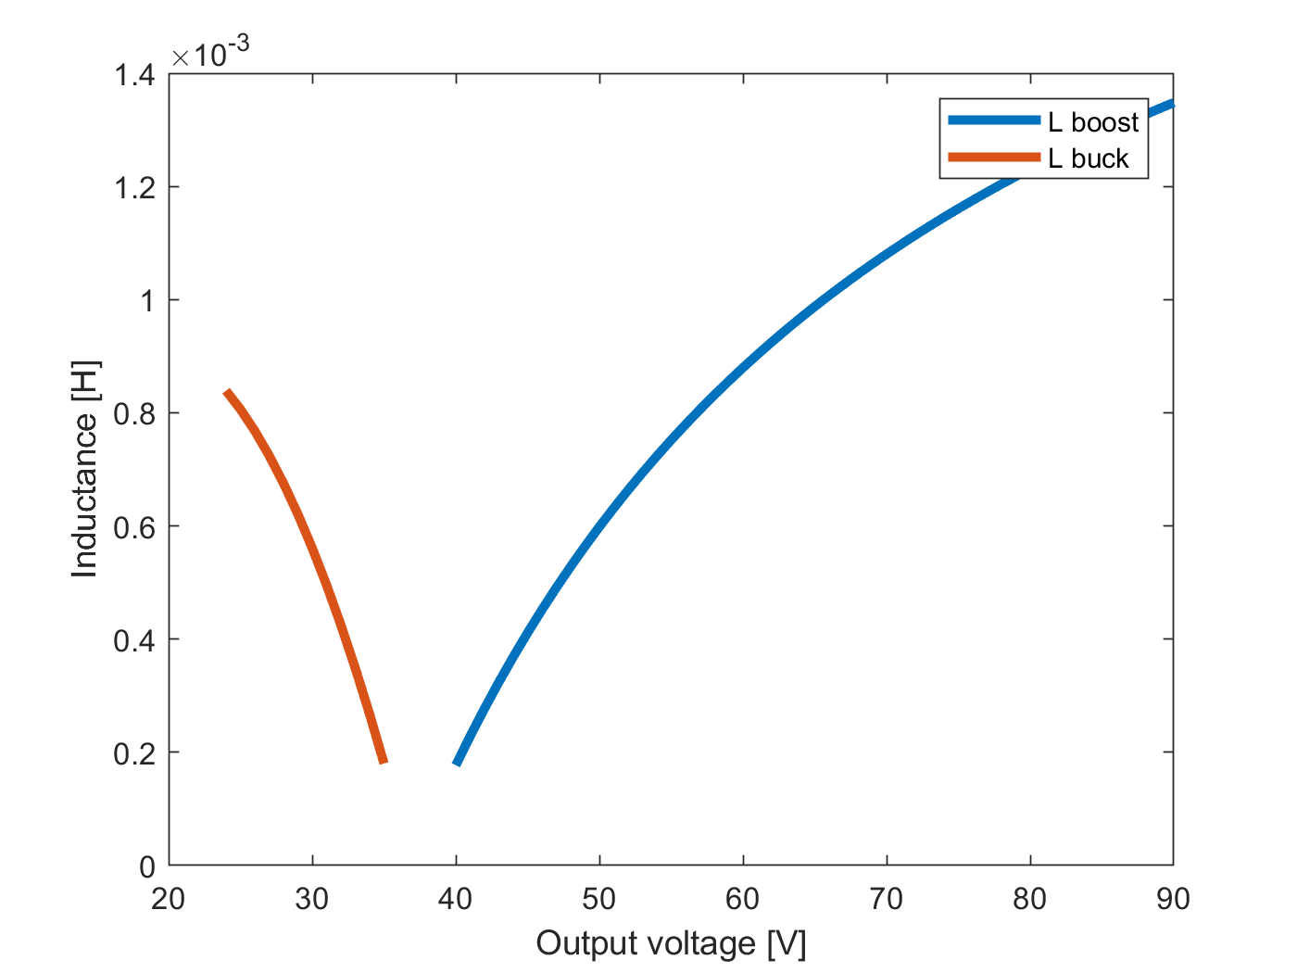
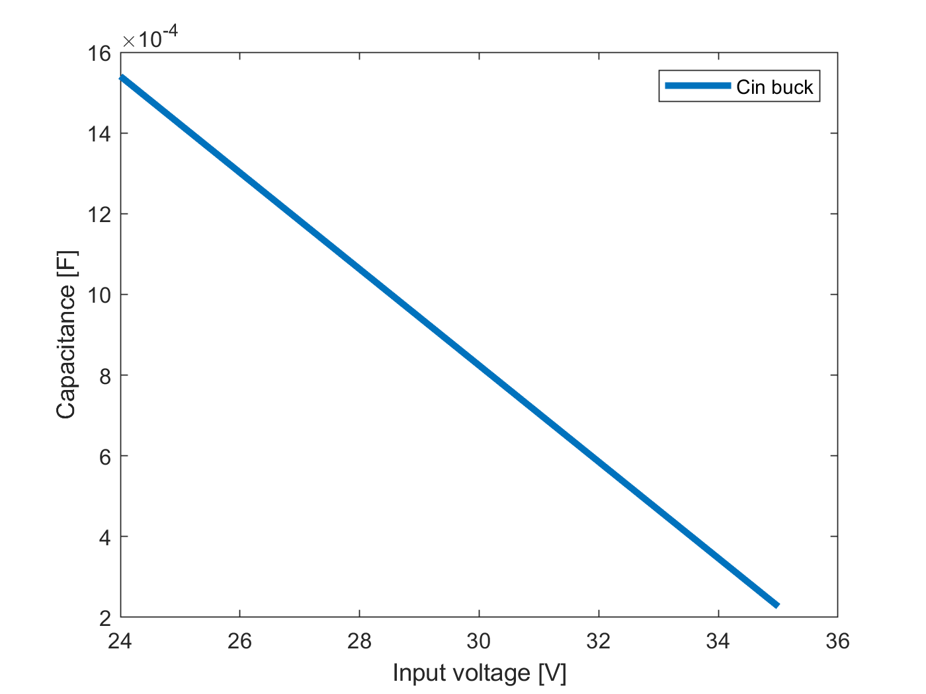
Passive components Sizing

Slide 14
Passive components Selection
Minimum 20% margin was included
Reused inductor
Component | Theoretical value | Implemented value | Voltage rating
Input capacitor | 1540µF | 1880µF | 100V
Output capacitor | 130µF | 820µF | 250V
Inductor | 1.3mH | 1.93mH | -
Notes:
Input cap is 4*470uF
Calculation mistakes lead to wrongly selected cout

Slide 15
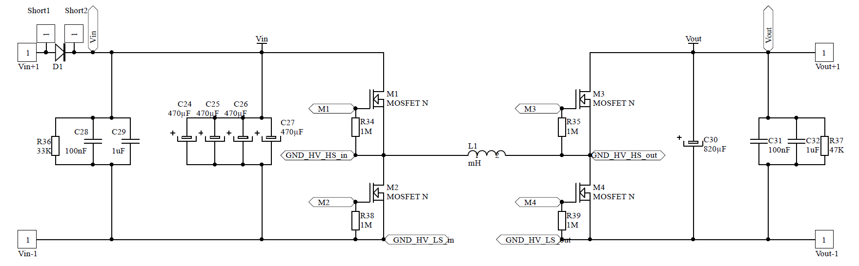
Power circuitry
High frequency capacitors.
Discharging resistors.
Protection diodes.

Slide 16
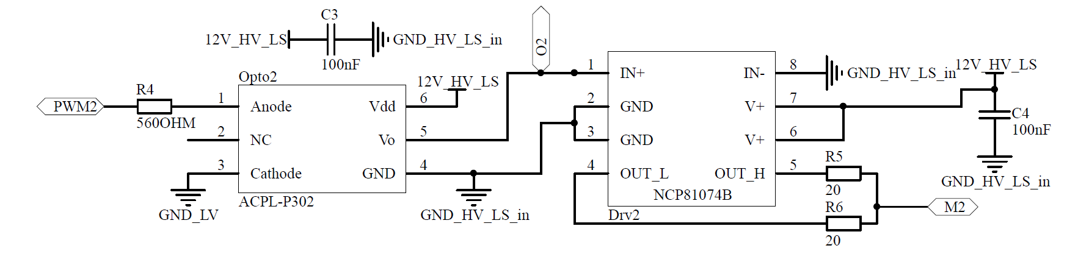
Driving circuitry
Optocouplers for isolation.
Current limiting resistors.
Decoupling capacitors.

Slide 17
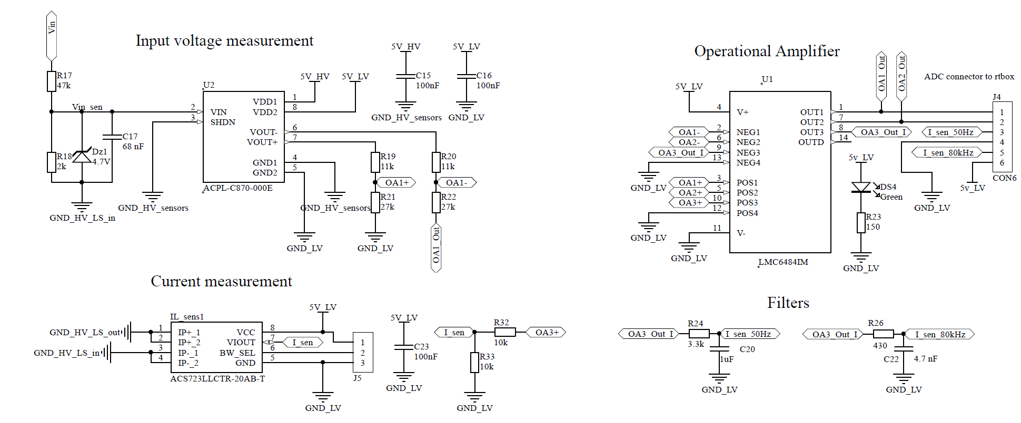
Sensor circuitry
Notes:
Optical unity-gain amplifier – voltage sensors
Hall effect – current sensor

Slide 18
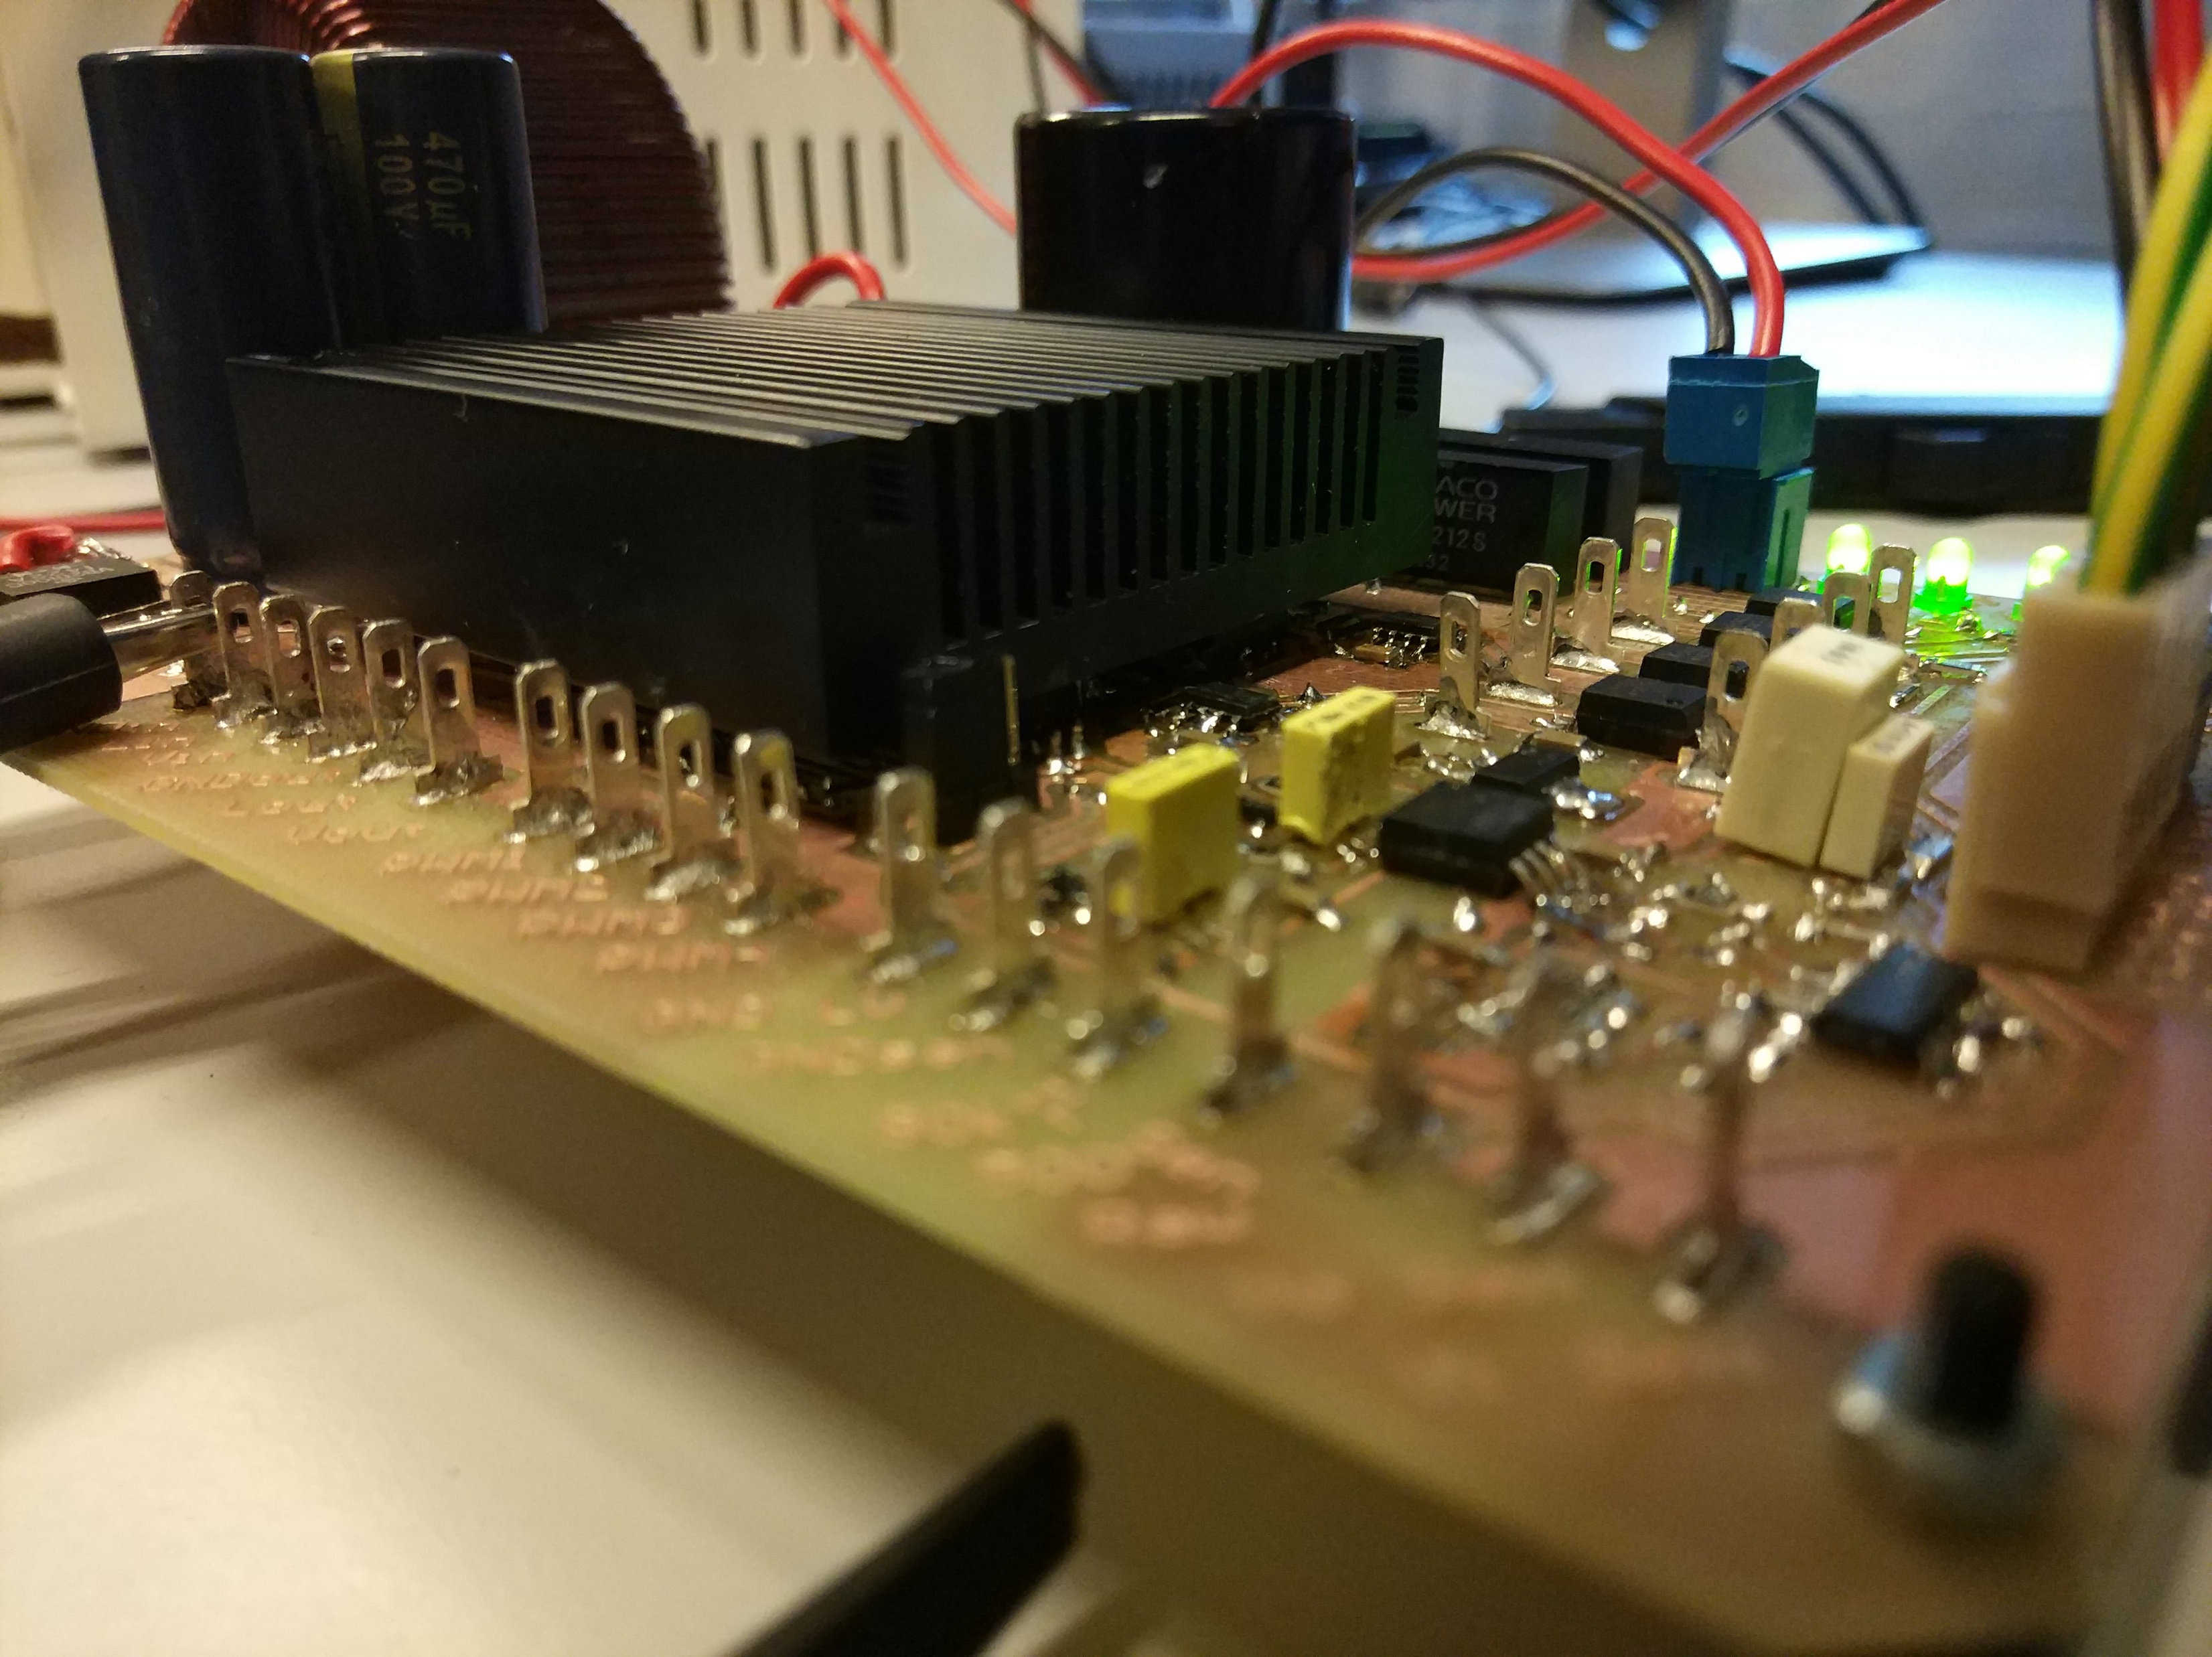
Power supplies
External supplies
Isolated 12V TRACO supplies
Linear 5V voltage regulator
LED at every supply line

Slide 19
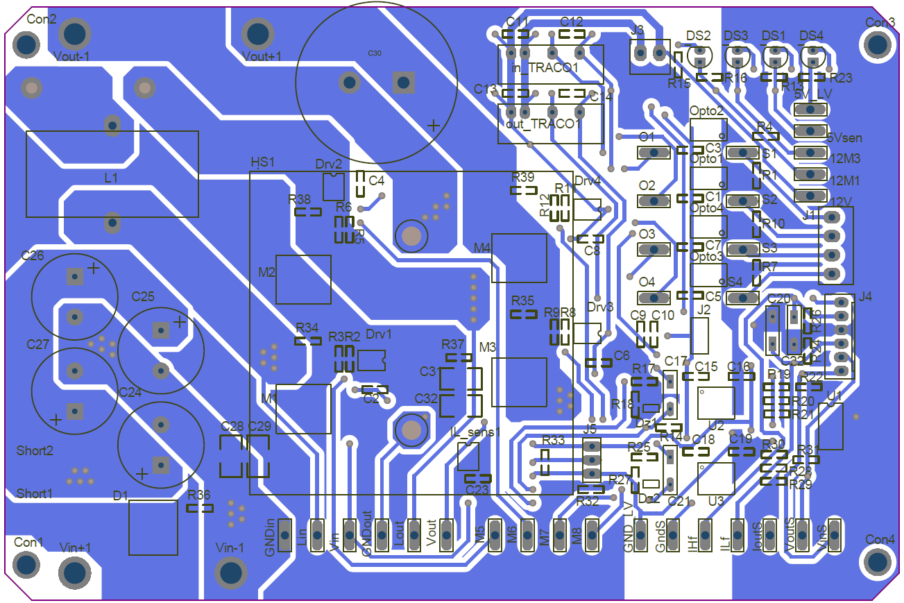
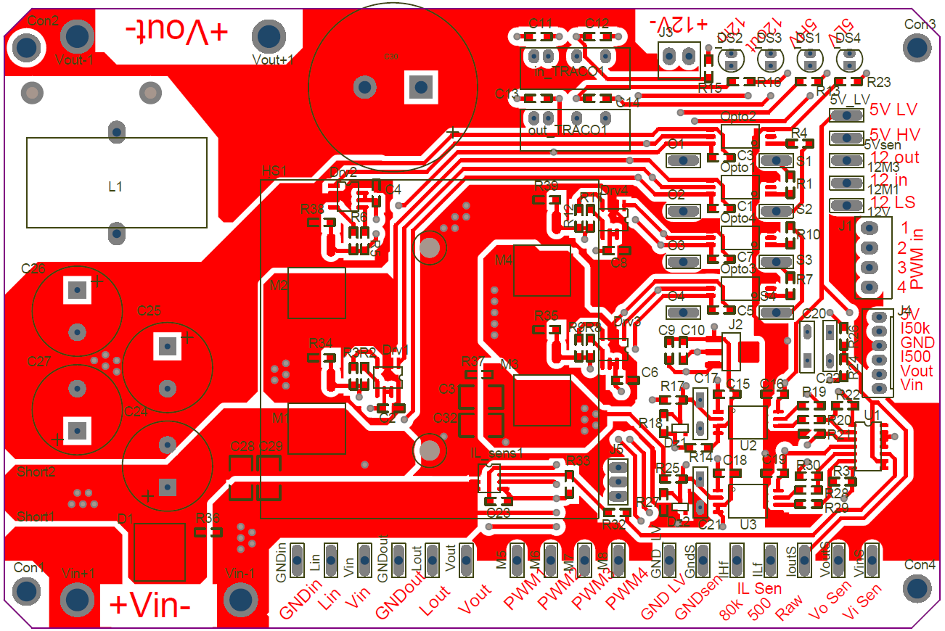
PCB layout
Considerations:
Hot and cold sides.
Isolations.
EMI - EMC.
Others.

Slide 20
Hot and cold sides
Clear separation of hot and cold sides.
Power side.
Control side, non-isolated.
Control side, isolated.

Slide 21
EMI - EMC
Reduced current loops.
Hall sensor location.
Ground planes.

Slide 22
Isolations
Isolation gap.

Slide 23
Others
Test points.
Other measuring points and user communication.
Heat sink location.
10mm power traces.

Slide 24
MPPT Algorithm

Slide 25
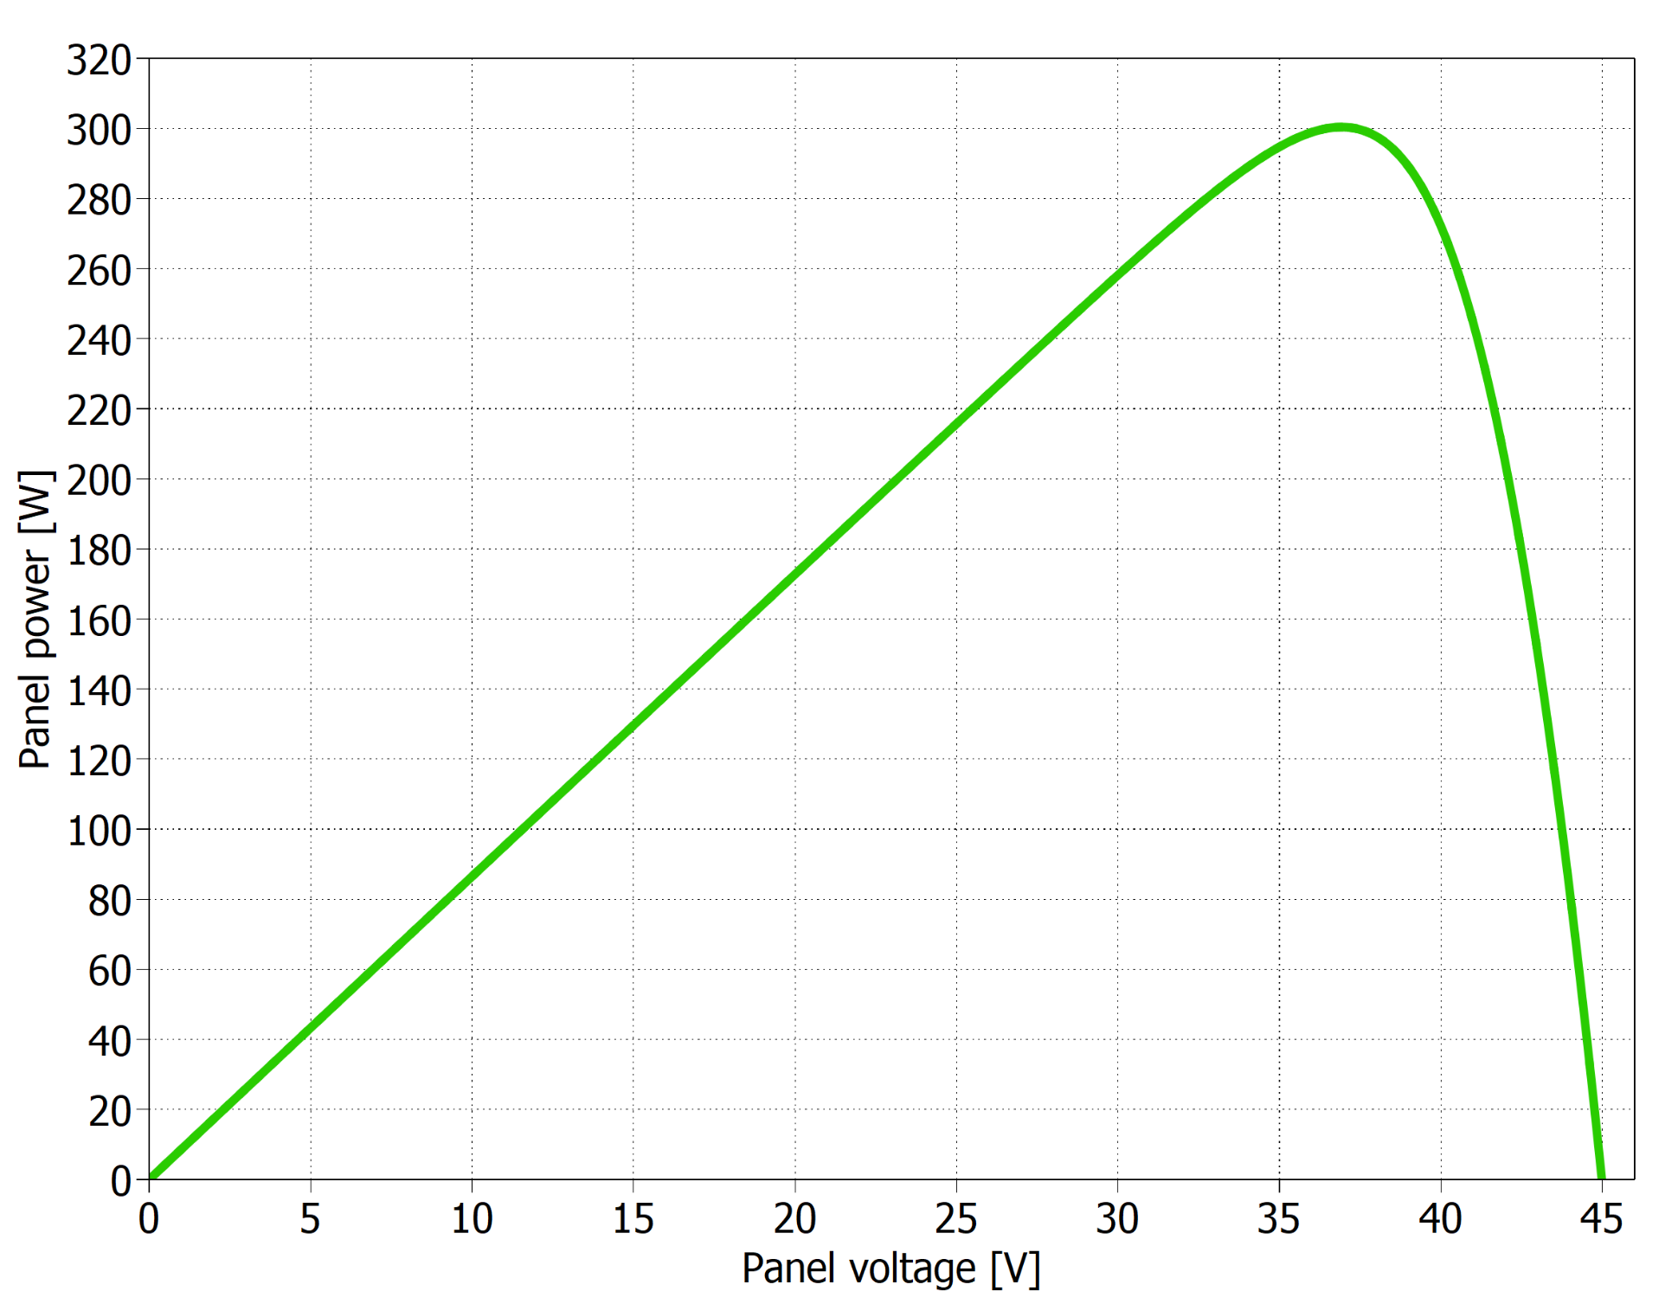
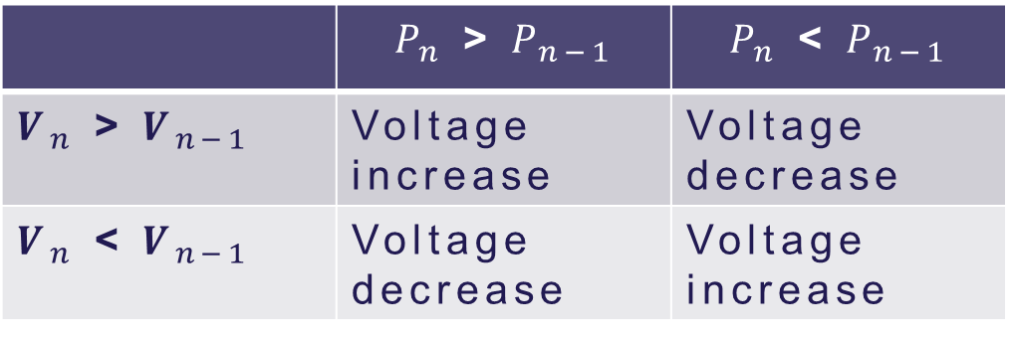
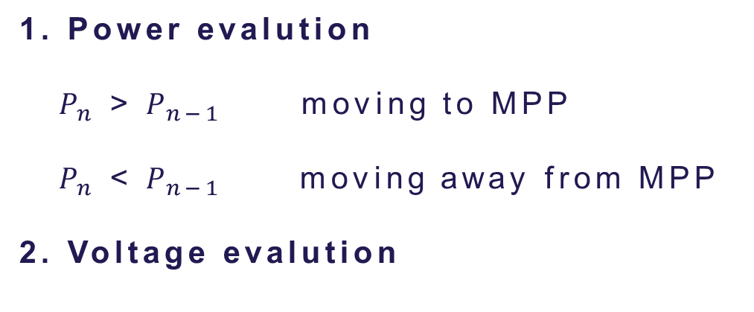
Perturb & Observe technique
1. Power evalution
$P_{n}$ > $P_{n−1}$ moving to MPP
$P_{n}$ < $P_{n−1}$ moving away from MPP
2. Voltage evalution
 | $P_{n}$ > $P_{n−1}$ | $P_{n}$ < $P_{n−1}$
$V_{n}$ > $V_{n−1}$ | Voltage increase | Voltage decrease
$V_{n}$ < $V_{n−1}$ | Voltage decrease | Voltage increase
P-V curve from a PV panel

Slide 26
Implementation
Block diagram of the system including the MPPT

Slide 27
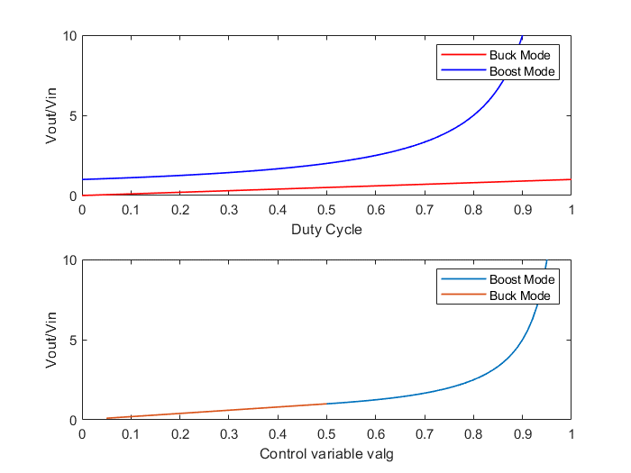

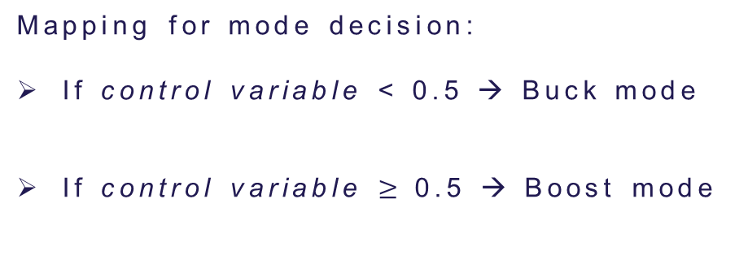

Initial MPPT implementation
$$\frac{V_{out}}{V_{in}}=D_{buck}$$
$\frac{V_{out}}{V_{in}}=$ $\frac{1}{1 − D_{boost}}$
Mapping for mode decision:
If control variable < 0.5 → Buck mode
If control variable $≥$0.5 → Boost mode
Top figure: Conversion ratio for buck and boost modes.
Bottom figure: Mapping of the control variable for mode decision.
Incrementing control variable means decreasing PV voltage!

Slide 28
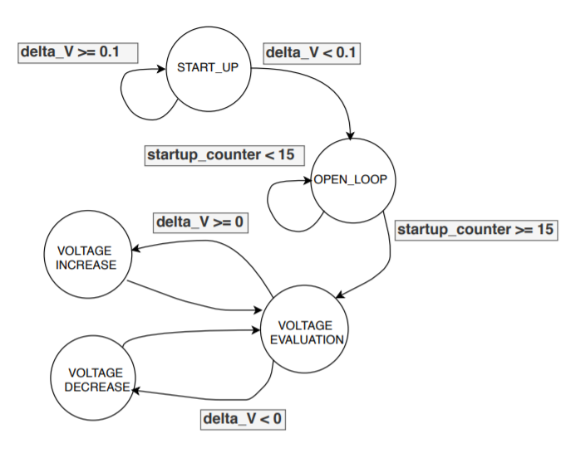

Initial MPPT implementation
Problems:
“If/else” structure difficult to find errors
Variable step required more complex code
Finite state machine for P&O algorithm

Slide 29
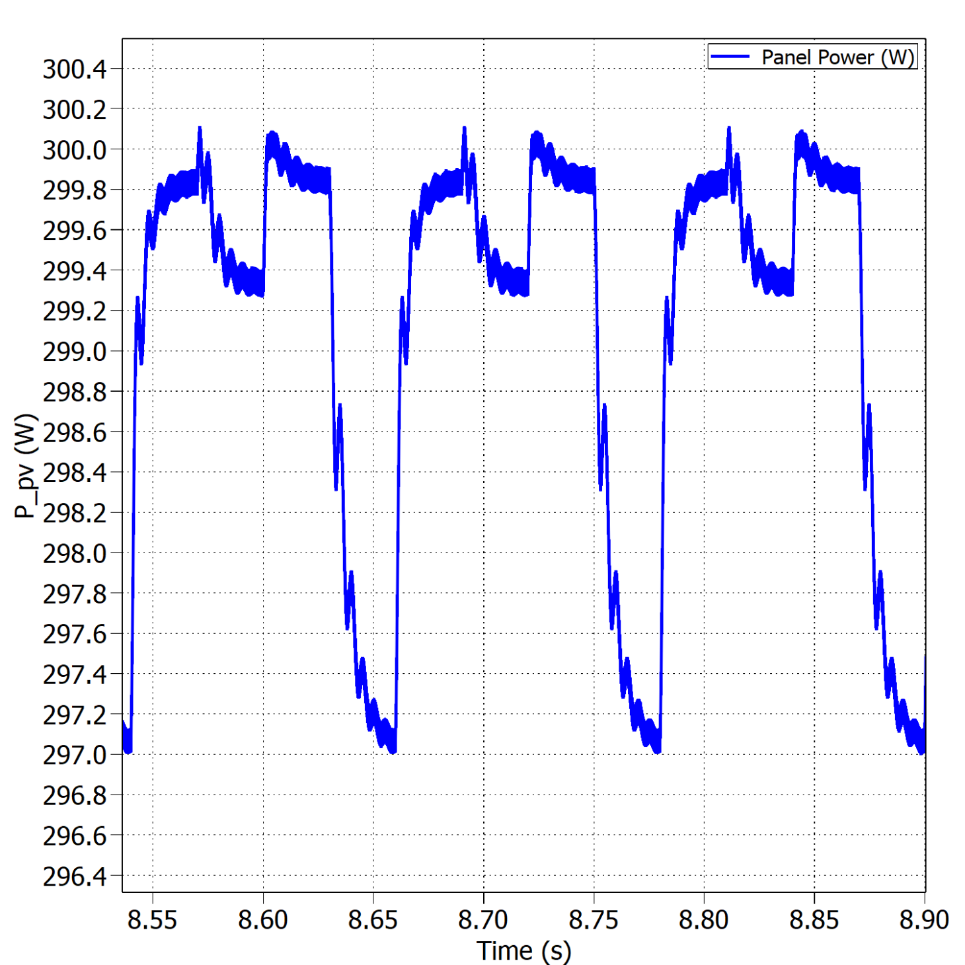
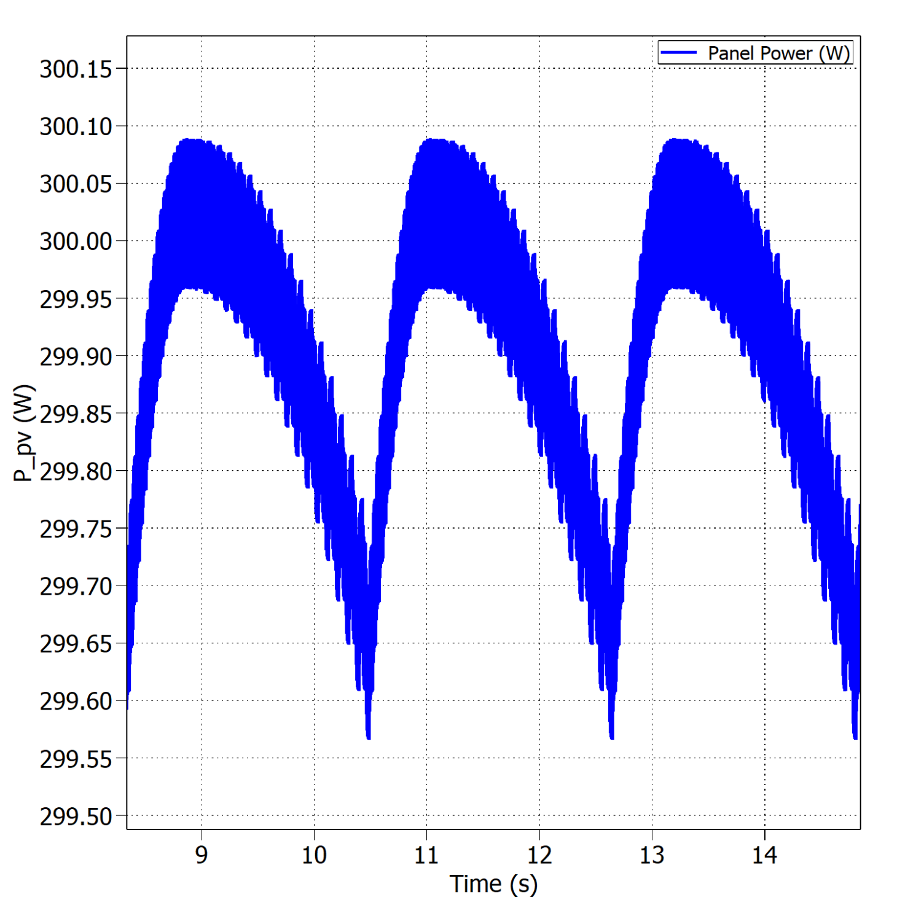


Fixed vs variable perturb step – Buck Mode
Oscillations around the MPP with fixed perturb step under STC.
Oscillations around the MPP with variable perturb step under STC.
$$η_{MPPT}=99.38\%$$
$$η_{MPPT}=99.96\%$$

Slide 30
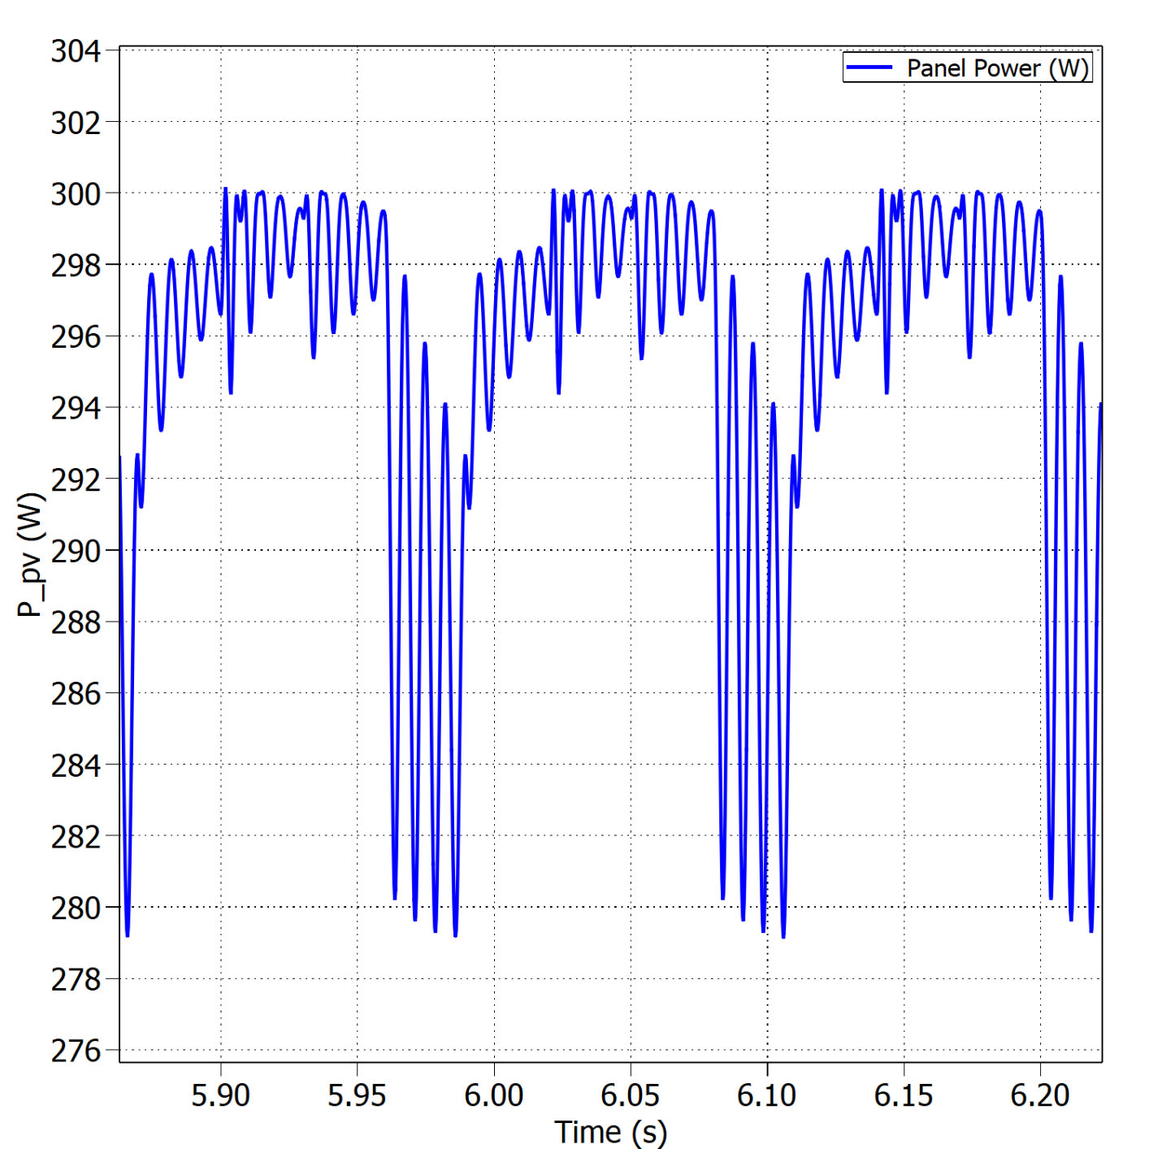
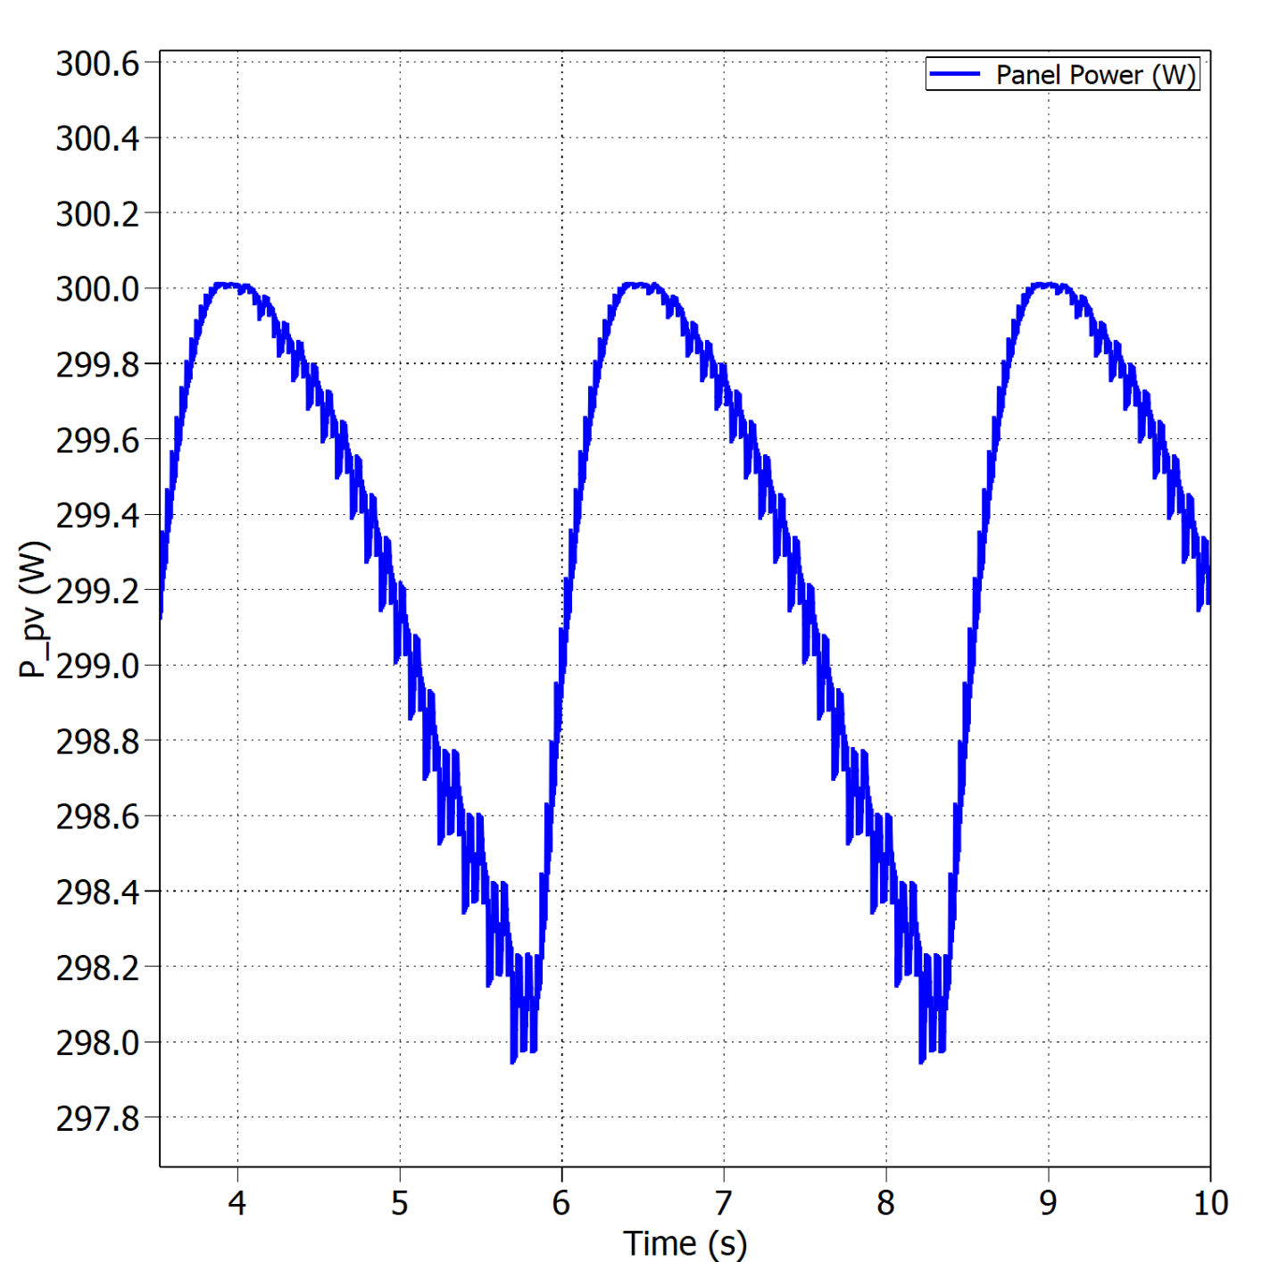


Fixed vs variable perturb step – Boost Mode
Oscillations around the MPP with fixed perturb step under STC.
Oscillations around the MPP with variable perturb step under STC.
$$η_{MPPT}=96.40\%$$
$$η_{MPPT}=99.82\%$$

Slide 31
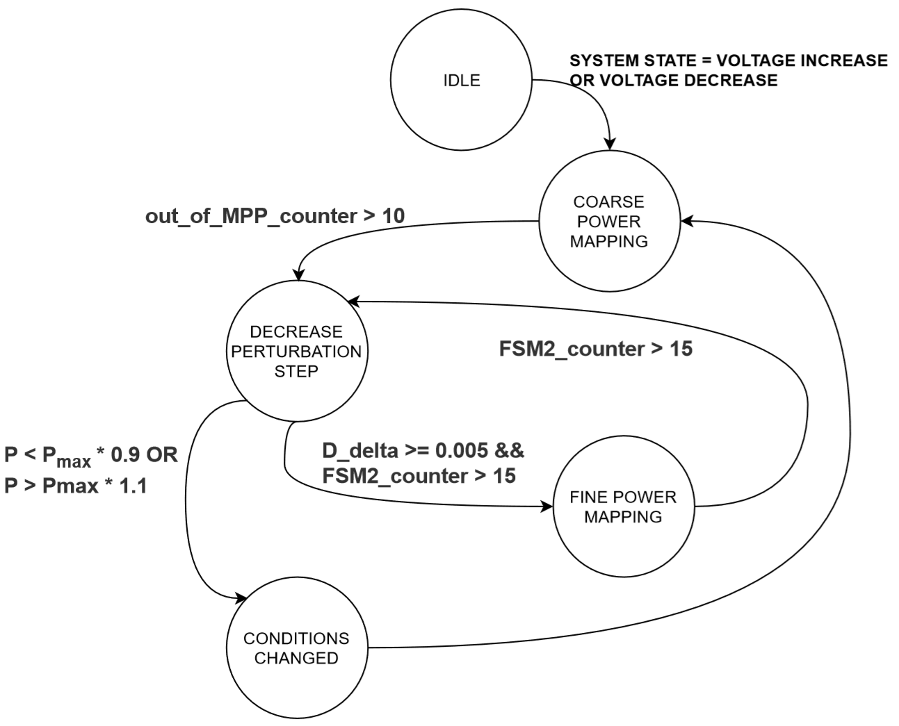
Final implementation
Main issues
Measurements were read too fast
Perturb step decreased after false positive MPP detection
Environmental variables’ changes

Slide 32



Final implementation
Pmax
Vmax
$$V_{MPP}$$
$$V_{MPP2}$$
Perturbation step & condition
change detection FSM

Slide 33
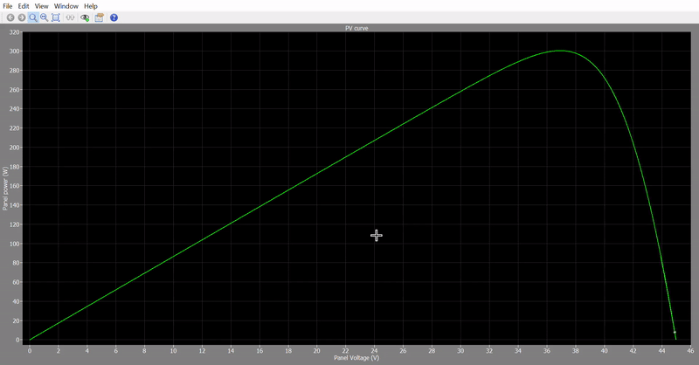
Final implementation
3 seconds sim time
Boost, 8 panels

Slide 34
Converter Design
Test Results

Slide 35
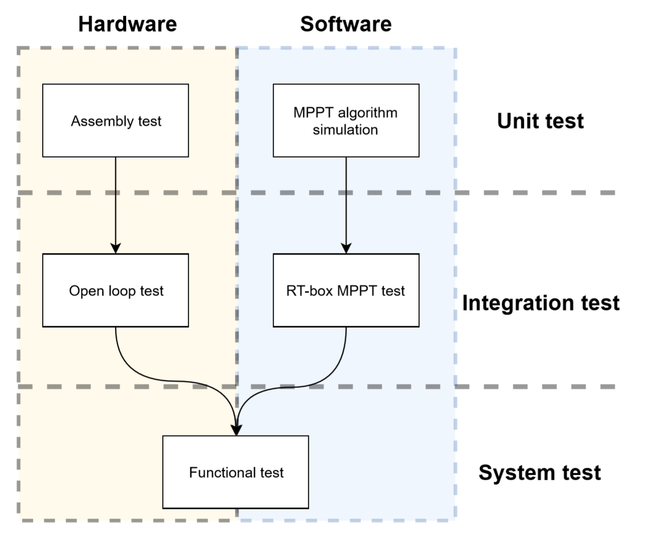
Testing Overview
Model of the PV panel
Standard test conditions
Boundary between modes of operation
Sudden changes in environmental
Converter’s efficiency
…

Slide 36
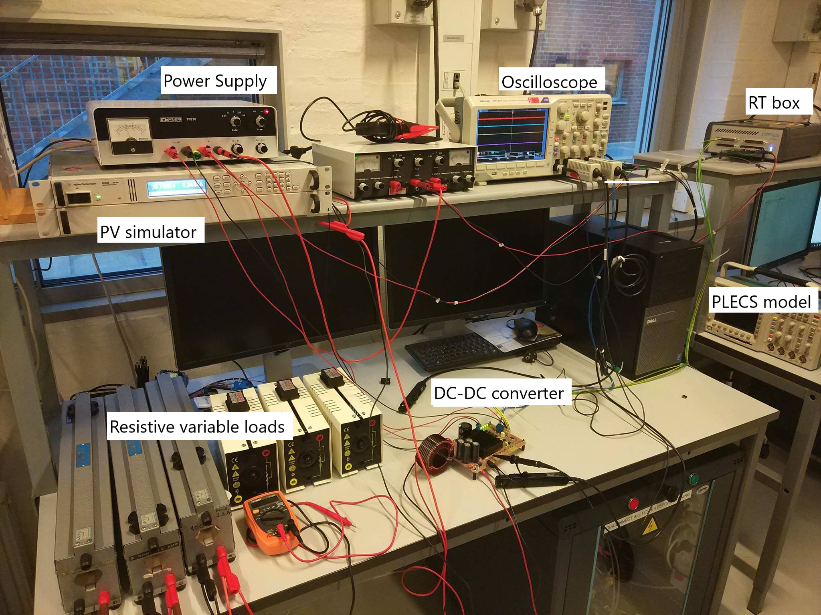
Test setup

Slide 37
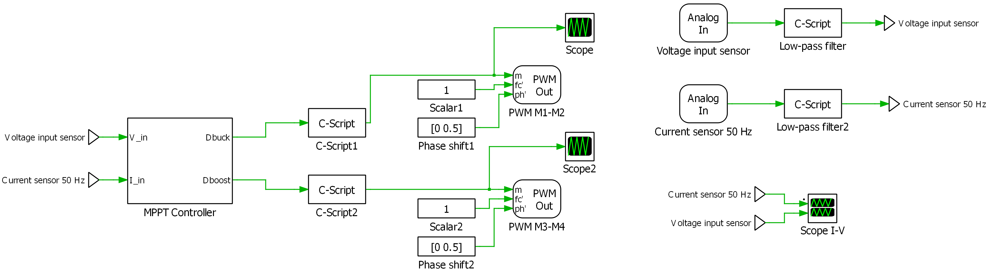
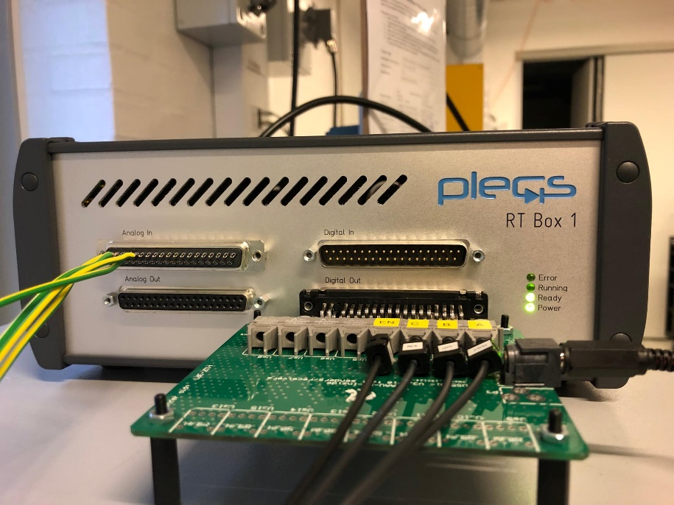
Test setup
PLECs model for interface with the RT Box.

Slide 38
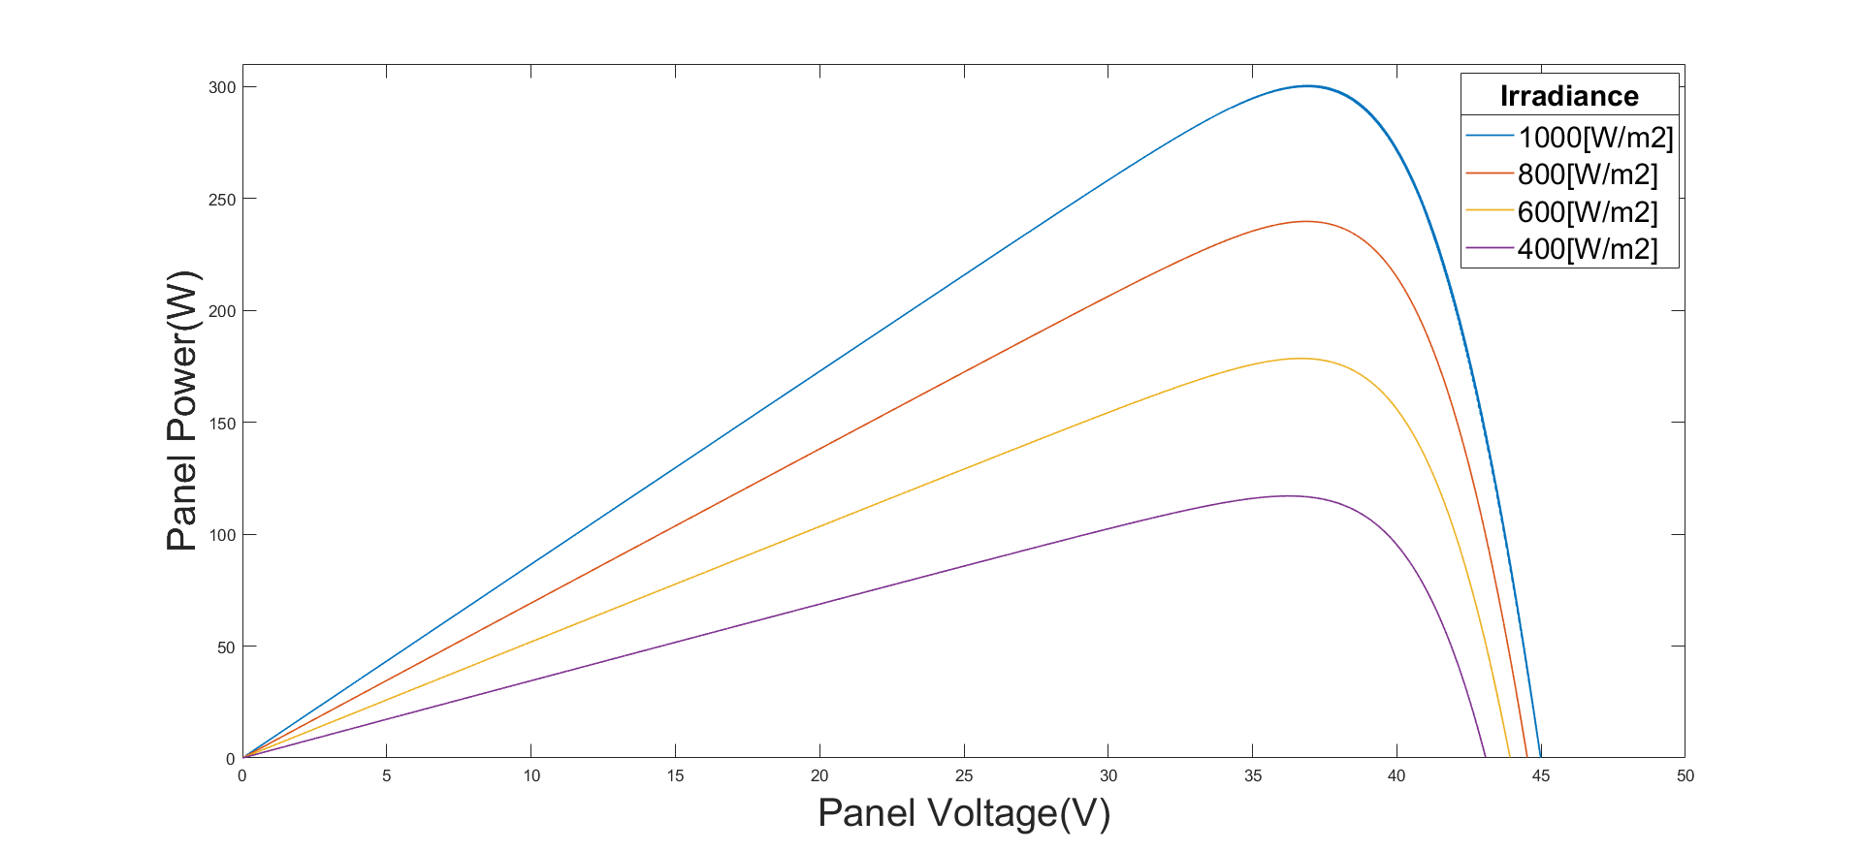
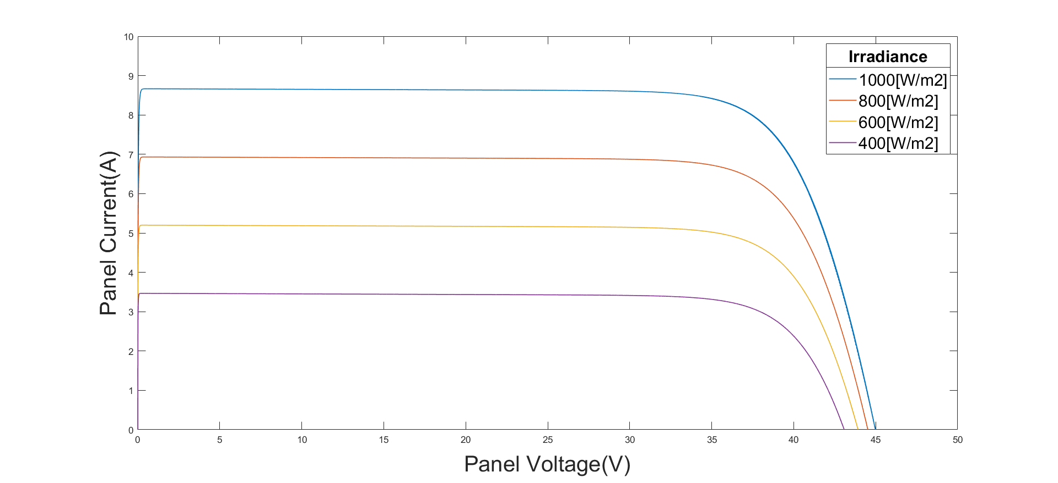
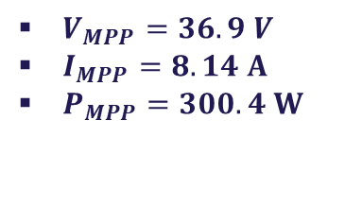
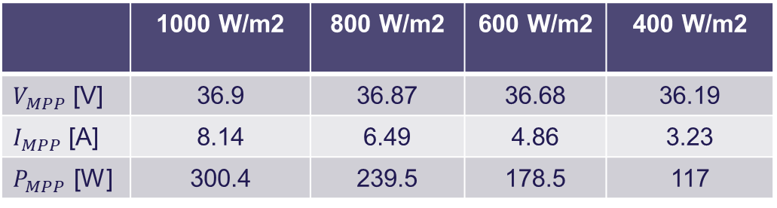
PV panel curves
$V_{MPP}=36.9 V$
$I_{MPP}=8.14 A$
$P_{MPP}=300.4 W$
Irradiance effect:
PV module datasheet (STC)
P-V curves for T=25ºC and varying irradiance.
I-V curves for T=25ºC and varying irradiance.
 | 1000 W/m2 | 800 W/m2 | 600 W/m2 | 400 W/m2
$V_{MPP}$ [V] | 36.9 | 36.87 | 36.68 | 36.19
$I_{MPP}$ [A] | 8.14 | 6.49 | 4.86 | 3.23
$P_{MPP}$ [W] | 300.4 | 239.5 | 178.5 | 117

Slide 39
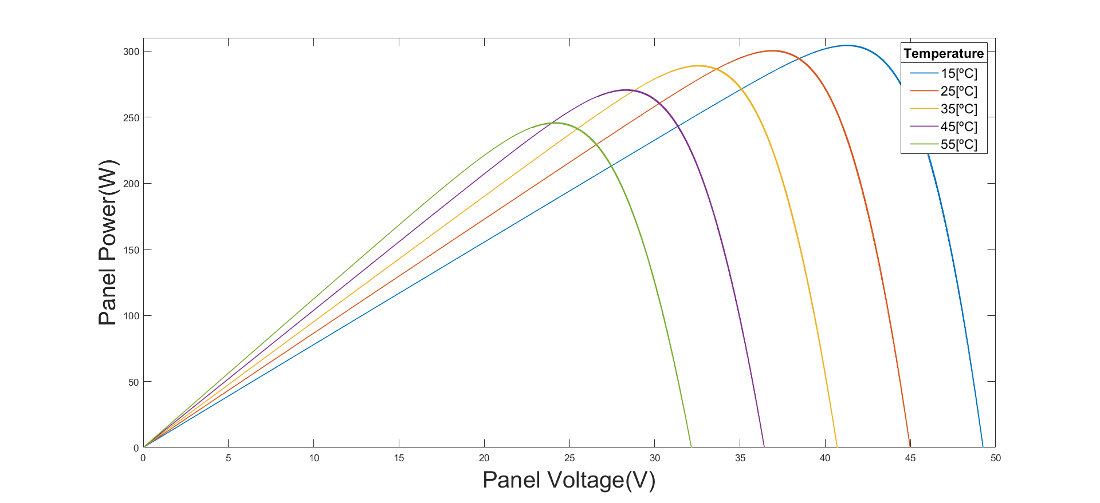
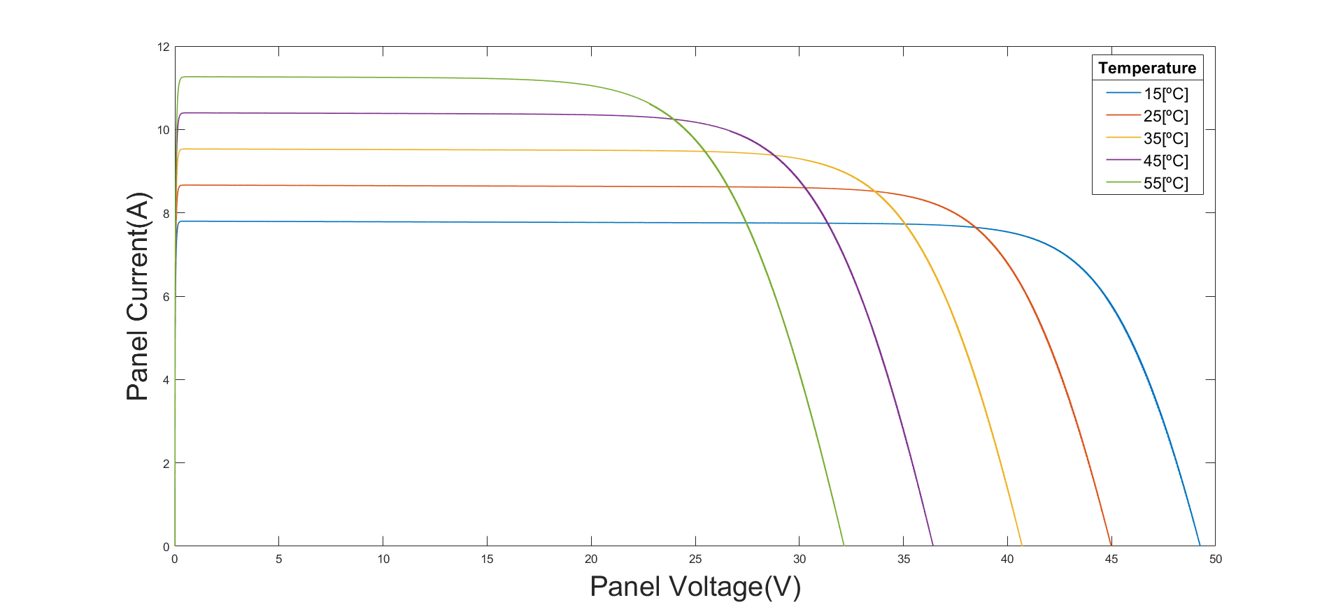
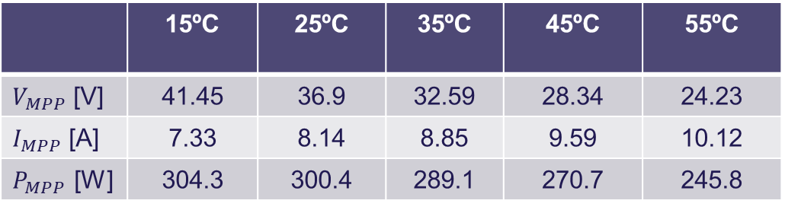
PV panel curves
Temperature effect:
P-V curves for 1000 W/m2 and varying temperature.
I-V curves for 1000 W/m2 and varying temperature.
 | 15ºC | 25ºC | 35ºC | 45ºC | 55ºC
$V_{MPP}$ [V] | 41.45 | 36.9 | 32.59 | 28.34 | 24.23
$I_{MPP}$ [A] | 7.33 | 8.14 | 8.85 | 9.59 | 10.12
$P_{MPP}$ [W] | 304.3 | 300.4 | 289.1 | 270.7 | 245.8

Slide 40
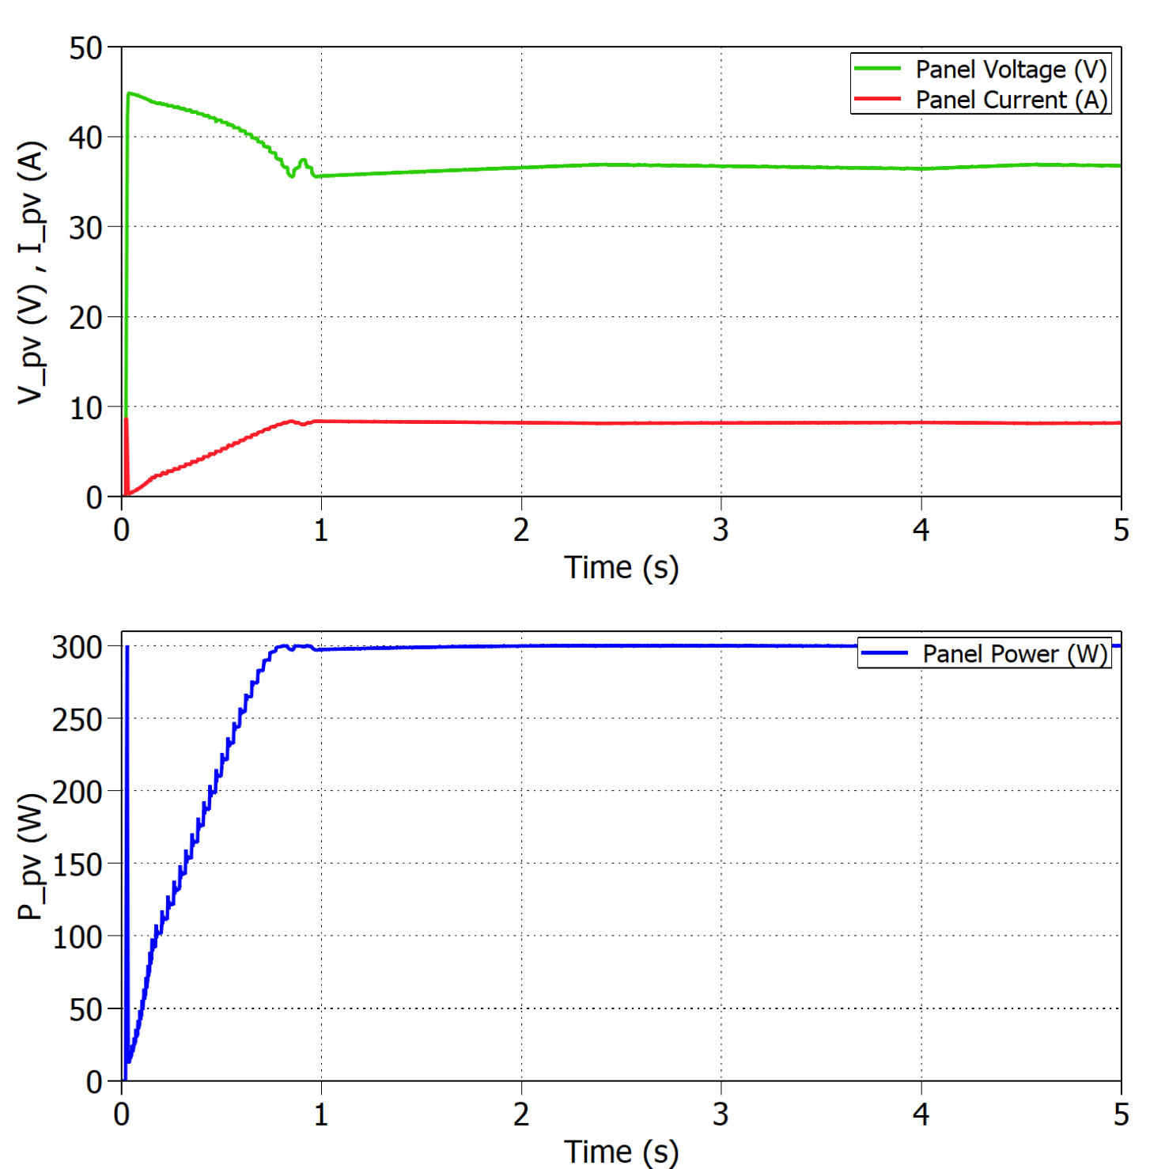
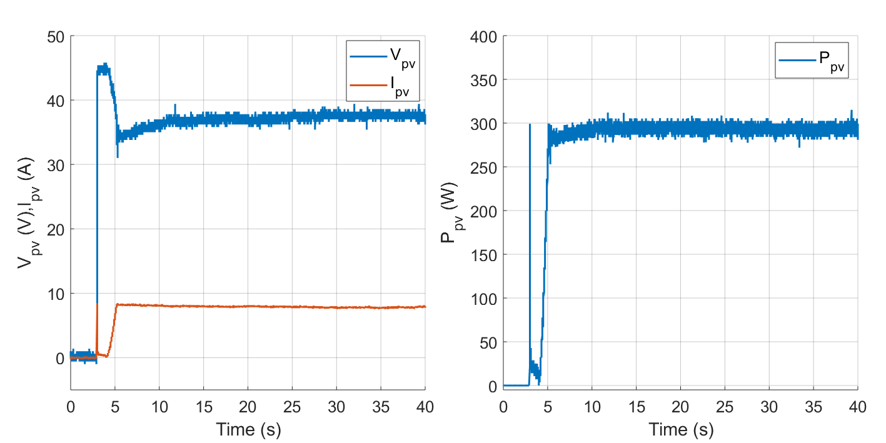
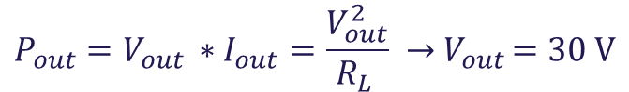


Standard Test Conditions (STC)
Buck mode:
Experimental results under STC with $R_{L}=3 Ω$.
$$P_{out}=V_{out }∗I_{out}=\frac{V_{out}^{2}}{R_{L }} →{ V}_{out }=30 V$$
$$η_{MPPTsim}=99.96\%$$
$$η_{MPPTexp}=97.72\%$$
Simulated results under STC with $R_{L}=3 Ω$.

Slide 41
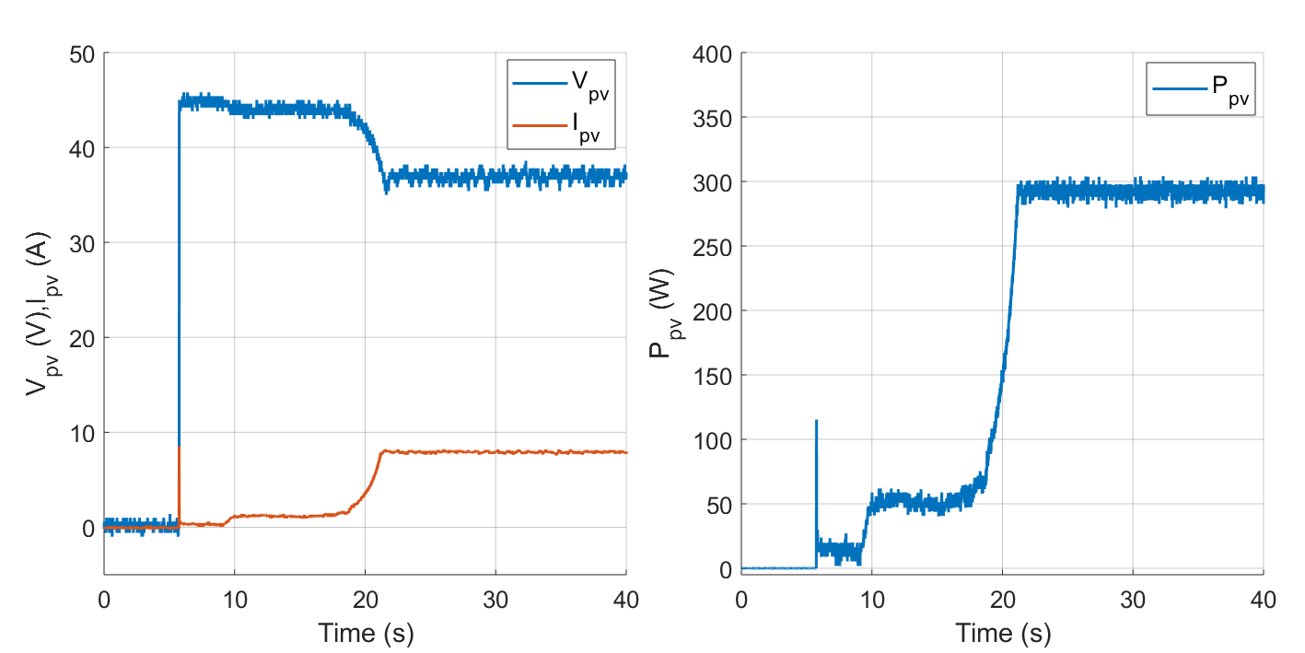
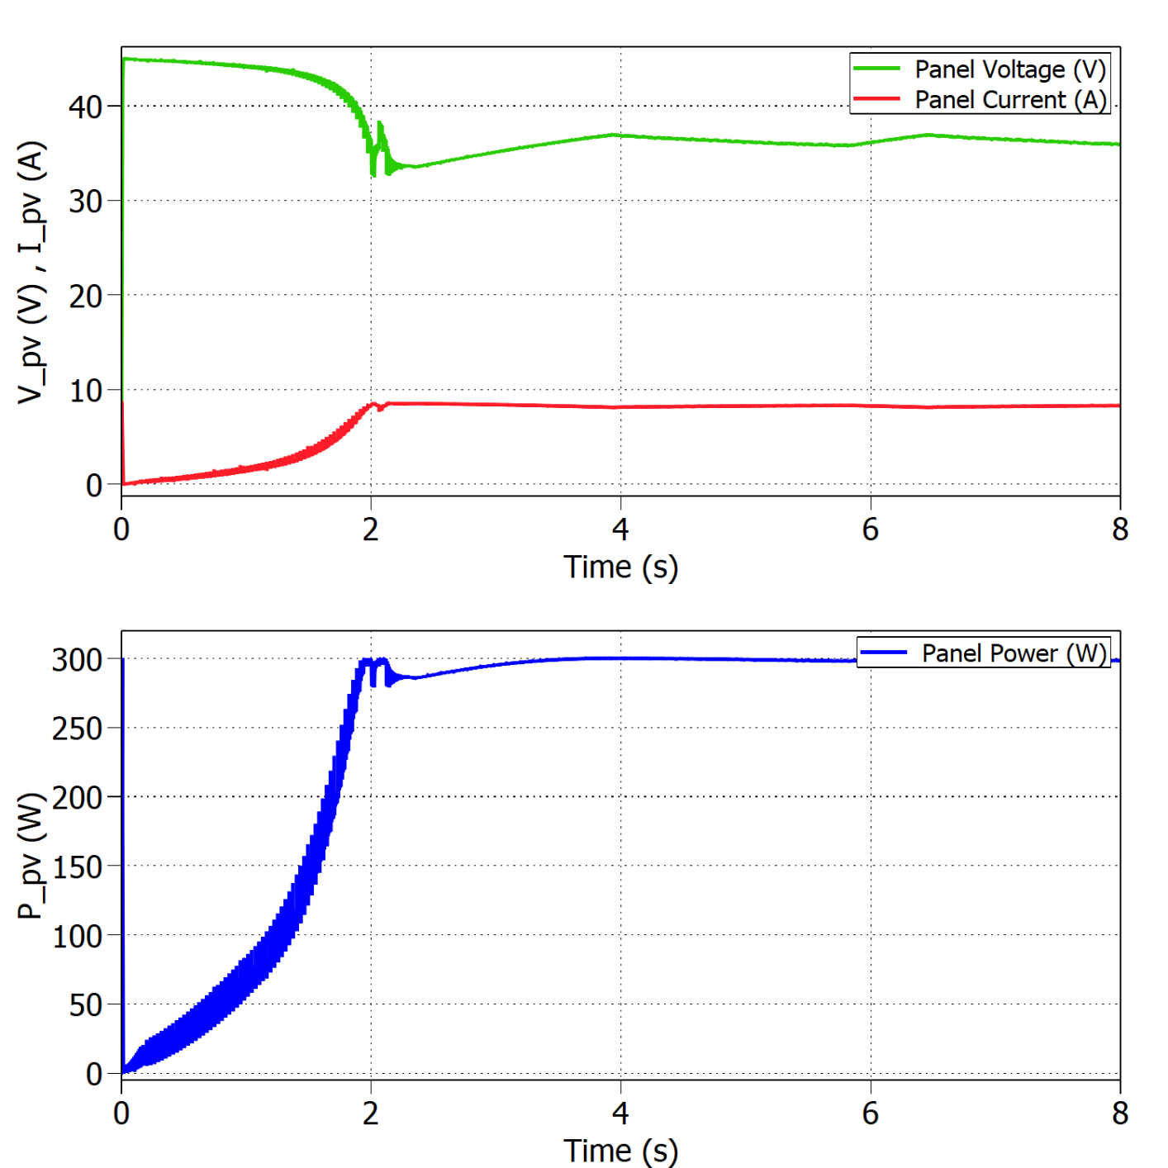
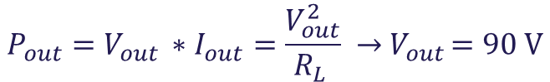


Standard Test Conditions (STC)
Boost mode:
Experimental results under STC with $R_{L}=27 Ω$.
$$P_{out}=V_{out }∗I_{out}=\frac{V_{out}^{2}}{R_{L }} →{ V}_{out }=90 V$$
Simulated results under STC with $R_{L}=27 Ω$.
$$η_{MPPTsim}=99.82\%$$
$$η_{MPPTexp}=97.32\%$$

Slide 42
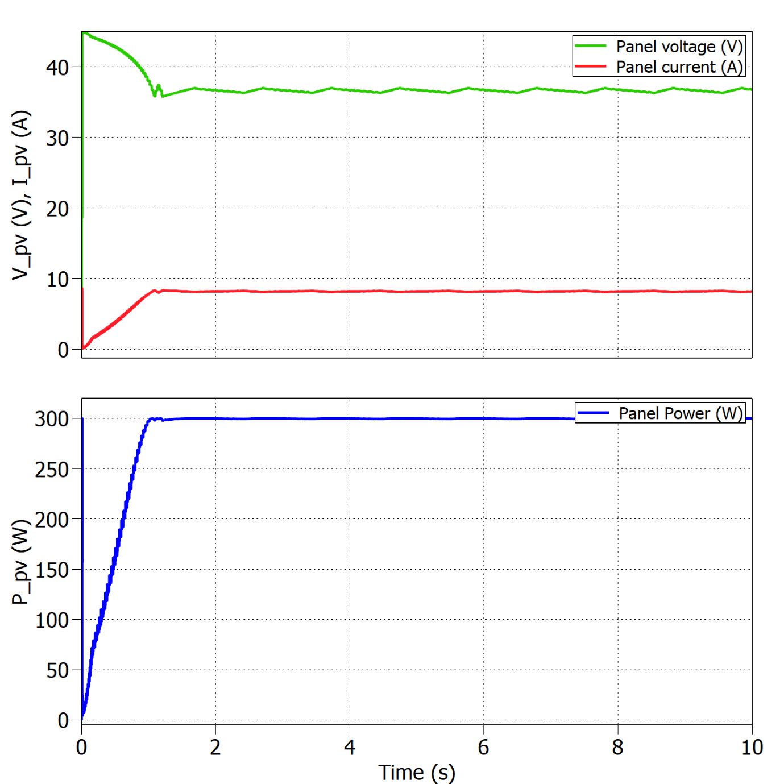
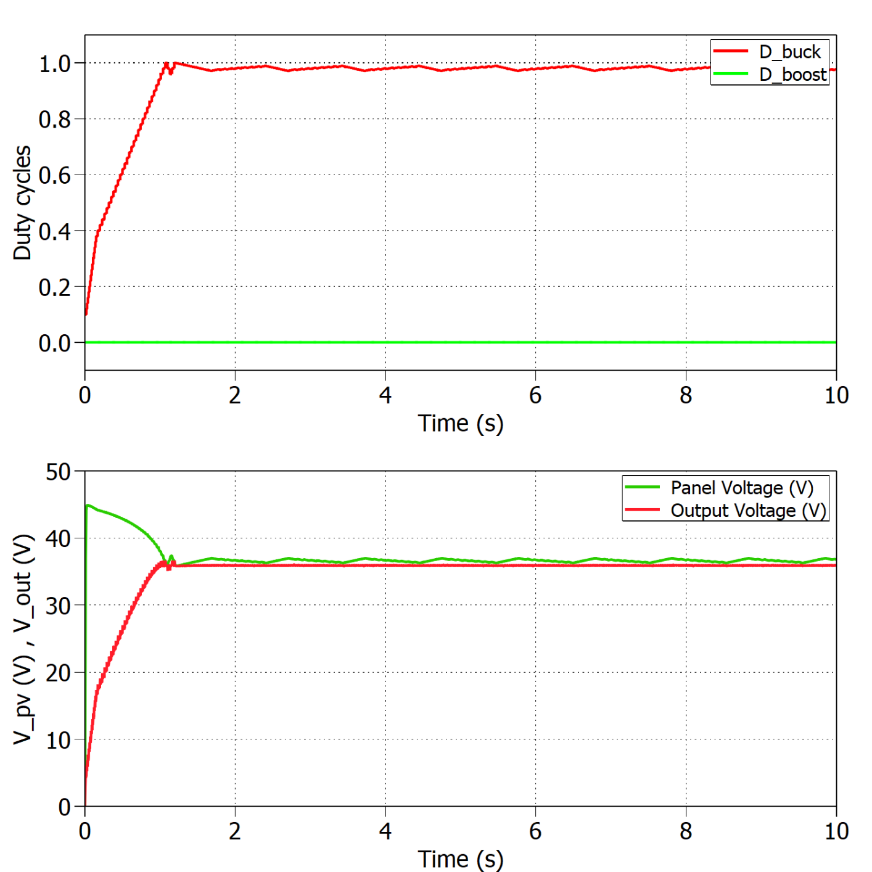



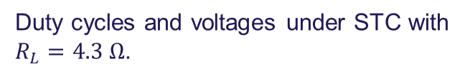
Boundary between modes of operation
Buck mode (10 PV panels):
$$R_{MPP}^{ }= \frac{V_{MPP}^{ }}{I_{MPP}^{ }} →R_{MPP}^{ }=4.53 Ω$$
9.75 panels →10 panels
If T>25ºC → Boost
$$η_{MPPT}=99.75\%$$
Panel’s voltage, current and power under STC with $R_{L}=4.3 Ω$.
Duty cycles and voltages under STC with $R_{L}=4.3 Ω$.

Slide 43
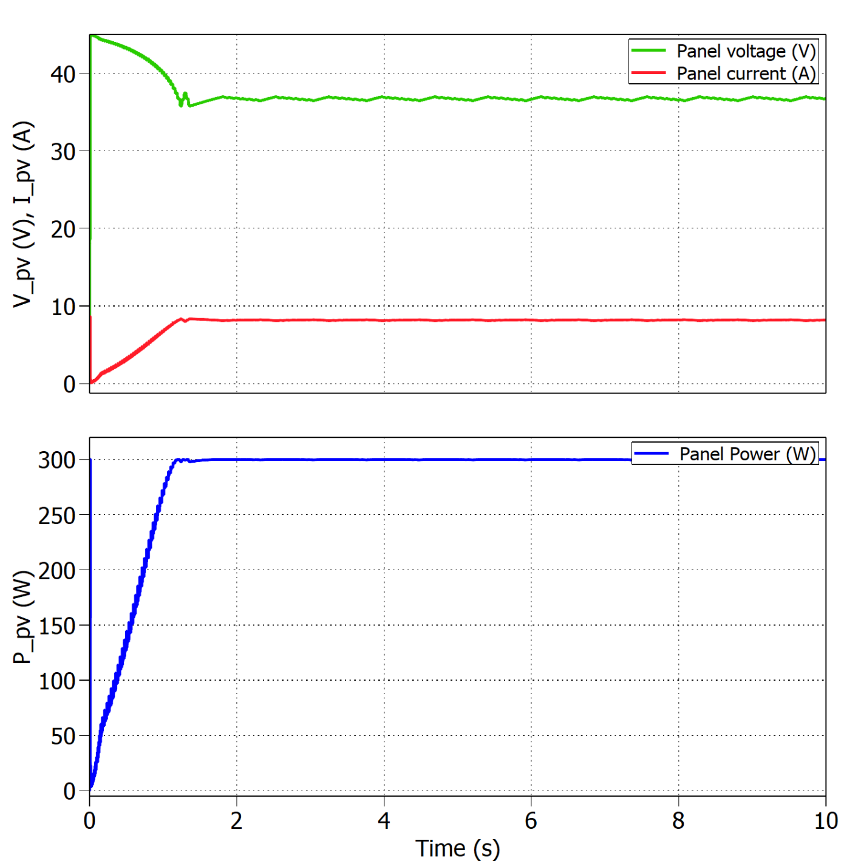
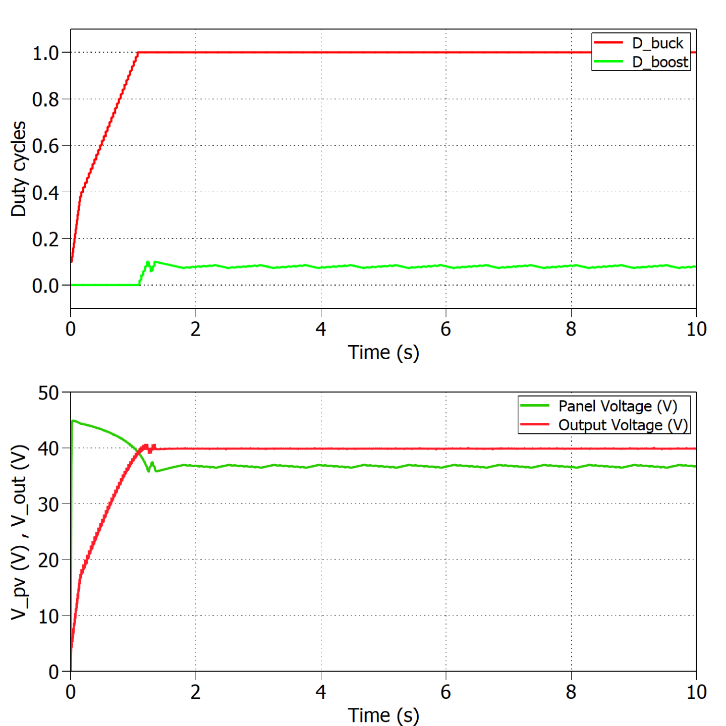



Boundary between modes of operation
Boost mode (9 PV panels):
$$R_{MPP}^{ }= \frac{V_{MPP}^{ }}{I_{MPP}^{ }} →R_{MPP}^{ }=4.53 Ω$$
9.75 panels →9 panels
If T<25ºC → Buck
$$η_{MPPT}=99.80\%$$
Panel’s voltage, current and power under STC with $R_{L}=5.3 Ω$.
Duty cycles and voltages under STC with $R_{L}=5.3 Ω$.

Slide 44





Sudden change in irradiance
Buck mode ${(R}_{L}=3 Ω)$:
Experimental results for 1000 - 800 W/m2 and constant temperature T=25ºC.
Simulated results for 1000 - 800 W/m2 and constant temperature T=25ºC.
$$η_{MPPTsim}=99.70\%$$
$$η_{MPPTexp}=93.78\%$$

Slide 45




Sudden change in temperature
Buck mode ${(R}_{L}=3 Ω)$:
Experimental results for 25 - 15 ºC and constant irradiance 1000 W/m2.
$$η_{MPPTsim}=99.90\%$$
$$η_{MPPTexp}=98.40\%$$
Simulated results for 25 - 15 ºC and constant irradiance 1000 W/m2.

Slide 46




Comparison simulation and experiments
Buck STC | Simulation | Experiment
$$η_{MPPT}$$ | 99.96% | 97.72%
$$t_{MPPT}$$ | 2 s | 10 s
Boost STC
$$η_{MPPT}$$ | 99.82% | 97.32%
$$t_{MPPT}$$ | 4 s | 21 s
Buck 1000 - 800 W/m2
$$η_{MPPT}$$ | From 99.81% to 99.70% | From 95.96% to 93.78%
$$t_{MPPT}$$ | 0.5 s | 6.6 s
Buck 25 - 15 ºC
$$η_{MPPT}$$ | From 99.81% to 99.90% | From 99.20% to 98.40%
$$t_{MPPT}$$ | 2 s | 4.1 s

Slide 47


Efficiency of the converter
Buck mode:
Voltages and powers at the converter’s input and output under STC.
$$η_{converter}=\frac{P_{out}}{P_{PV}} ∗100=93.15\%$$

Slide 48


Thermal test
Open-loop buck mode ${(R}_{L}=2 Ω)$:
Coil and heat sink temperature varying with time .
Thermal camera showing hot and cold spots in the PCB.

Slide 49
Discussion

Slide 50


Driver issues
[3]
Voltage spikes at gate

Slide 51


Driver issues
[3]
Voltage spikes removed

Slide 52
Voltage sensor issues
Design considered protection
Positive peak voltage protection
Output current limitation

Slide 53

Inductor
Loss of inductance
Temperature increase

Slide 54

Software filtering
V and I measurements are noisy
HW filtering at the output of the sensor is not enough
Single pole LPF implemented

Slide 55
Future work
Hardware improvements
Inductor design
PCB improvements
Converter’s efficiency
V/I controller

Slide 56
Conclusion

Slide 57
Conclusion
What went good
What went bad
What did we learn
Notes:
Add something about the general intro?

Slide 58

Thank you for your attention
Questions?
[4]

Slide 59
References
[1] http://www.safegardgroup.com/blog/2017/07/27/solar-panel-disposal3/
[2] https://www.dgem.nl/nl/zonne-energie/opbrengstvariabelen-zonnepanelen
[3] MOSFET Gate Drive Circuit, Toshiba, 2018
[4] https://www.thermofisher.com/blog/mining/mining-metals-for-a-renewable-energy-future/

